Slide 1

Course Code: INT232
DATA SCIENCE TOOLBOX : R PROGRAMMING
www.lpu.in Lovely Professional University
1

Slide 2


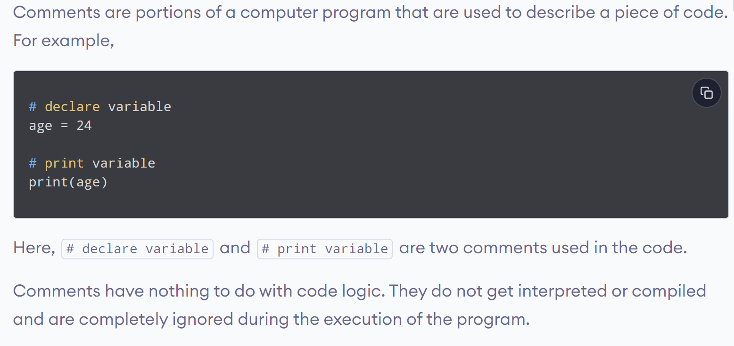
www.lpu.in Lovely Professional University
2

Slide 3
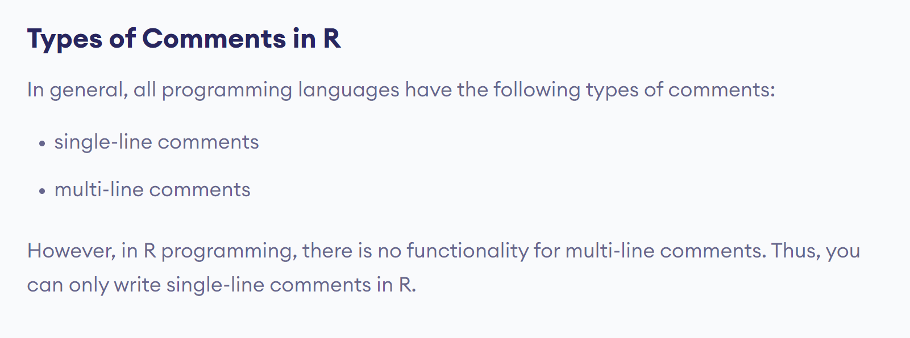
www.lpu.in Lovely Professional University
3

Slide 4
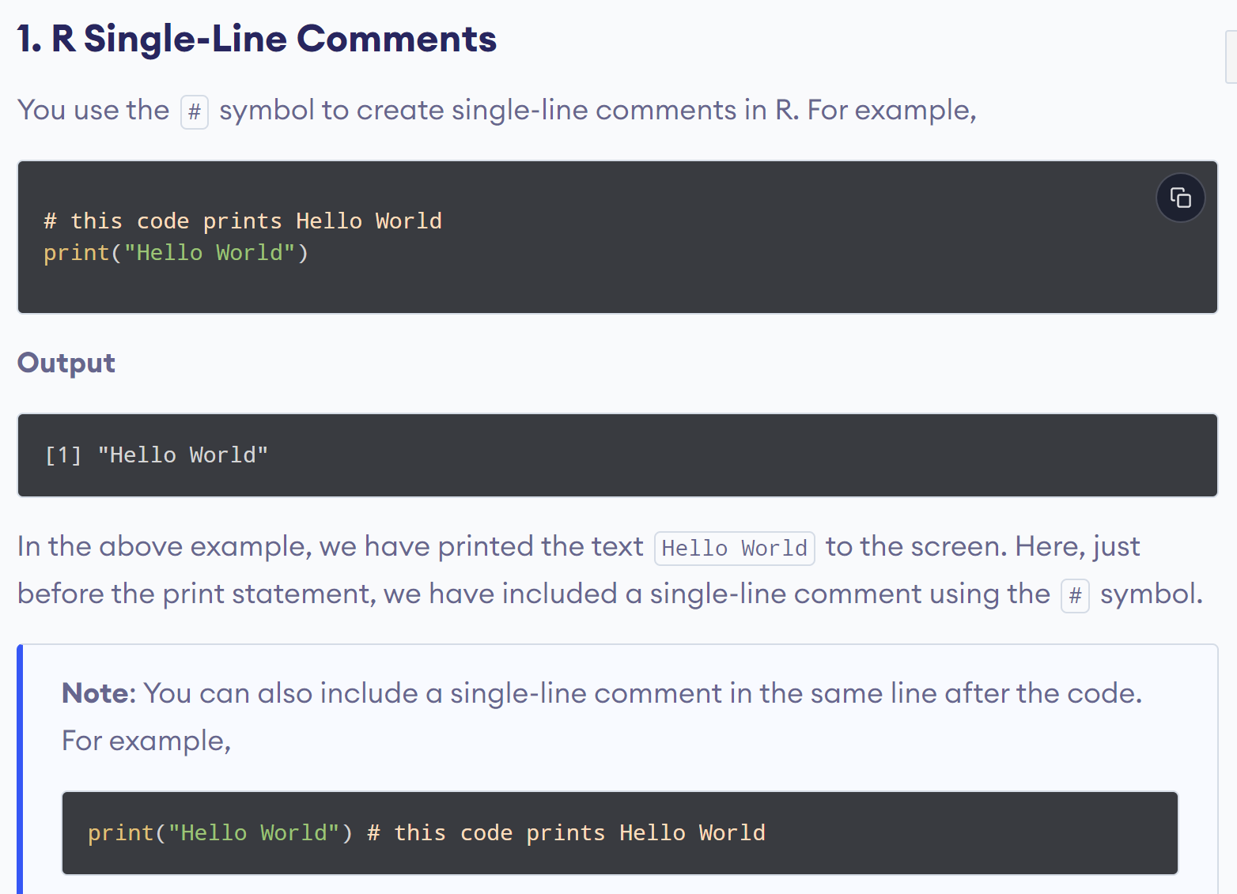
www.lpu.in Lovely Professional University
4

Slide 5
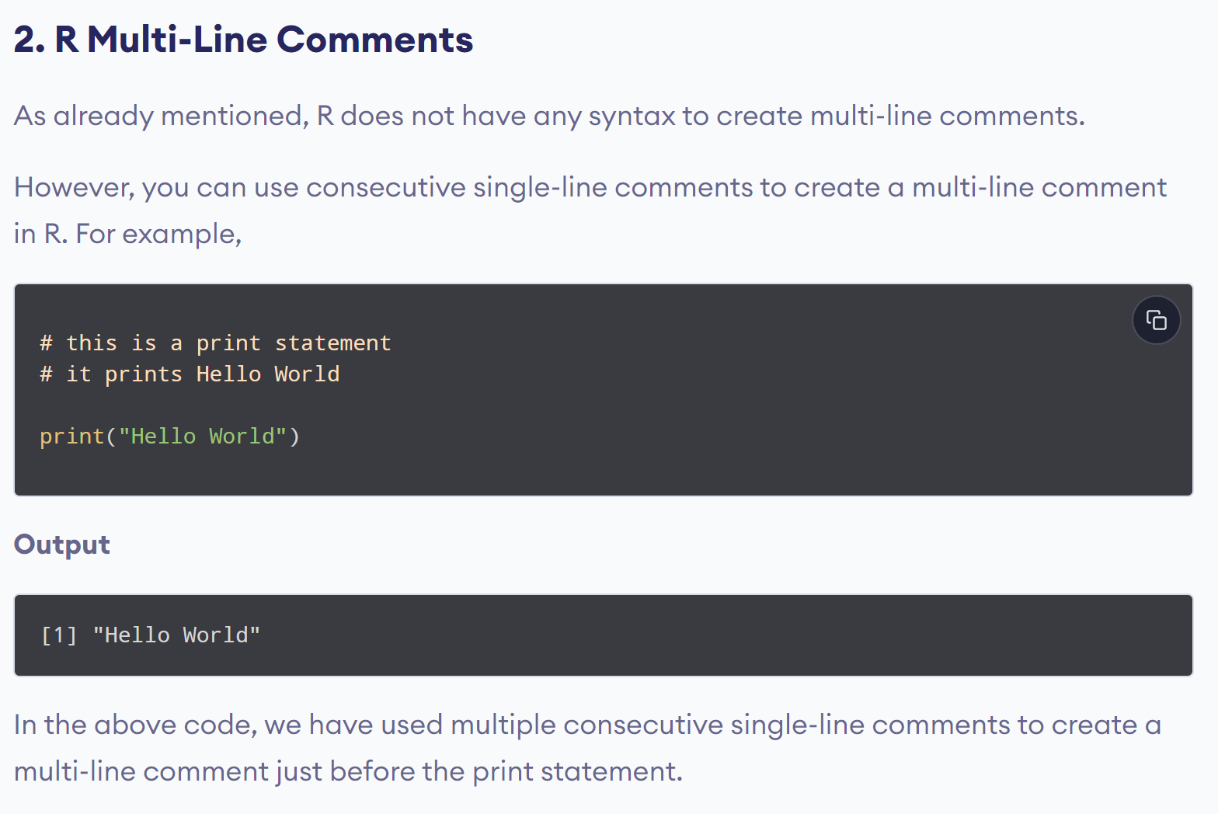
www.lpu.in Lovely Professional University
5

Slide 6
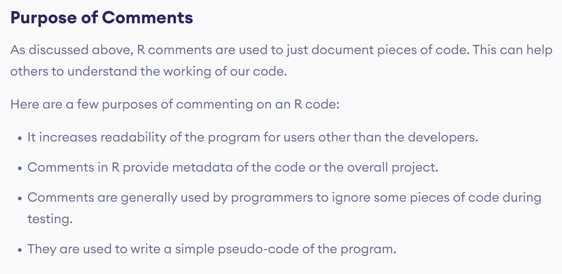
www.lpu.in Lovely Professional University
6

Slide 7
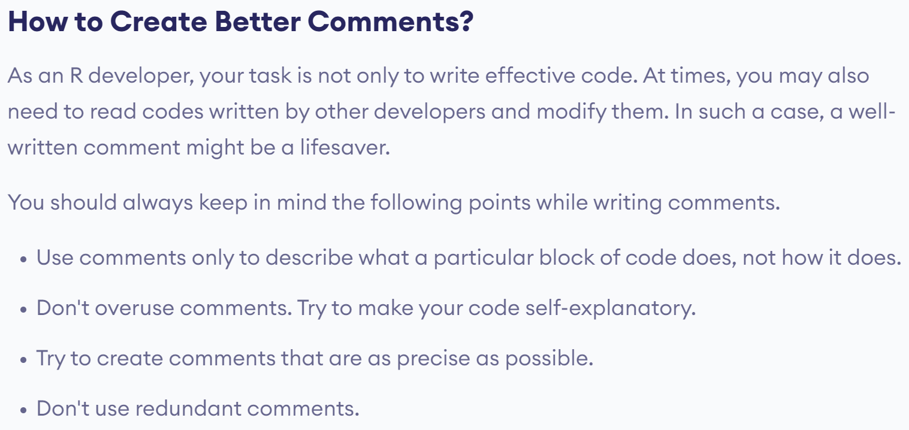
www.lpu.in Lovely Professional University
7

Slide 8

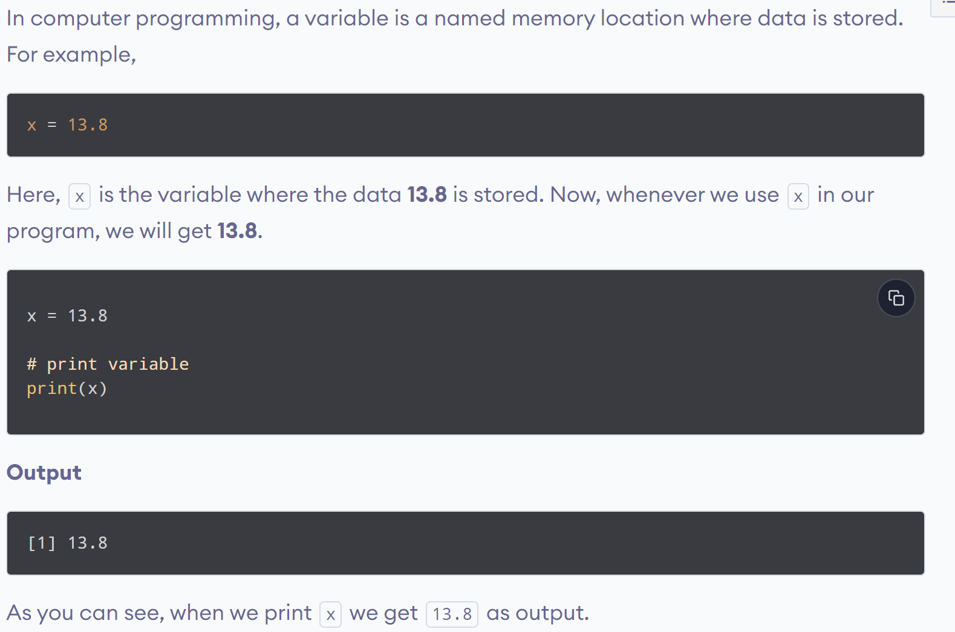
www.lpu.in Lovely Professional University
8

Slide 9
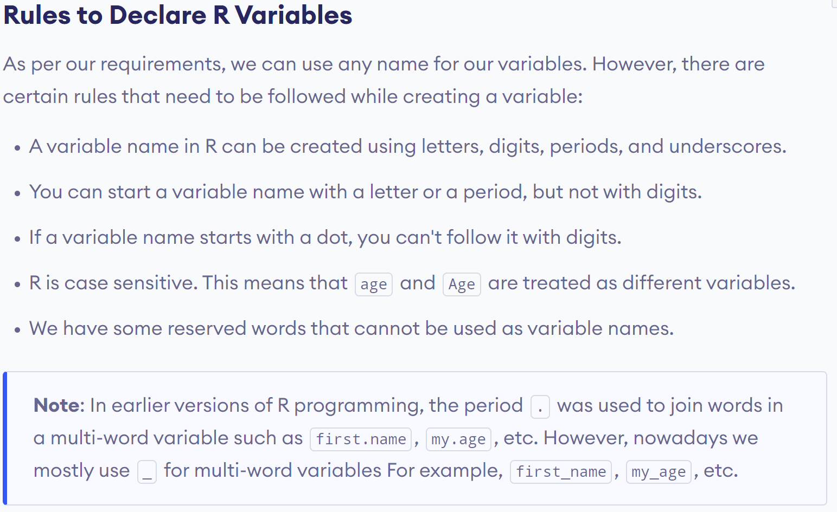
www.lpu.in Lovely Professional University
9

Slide 10
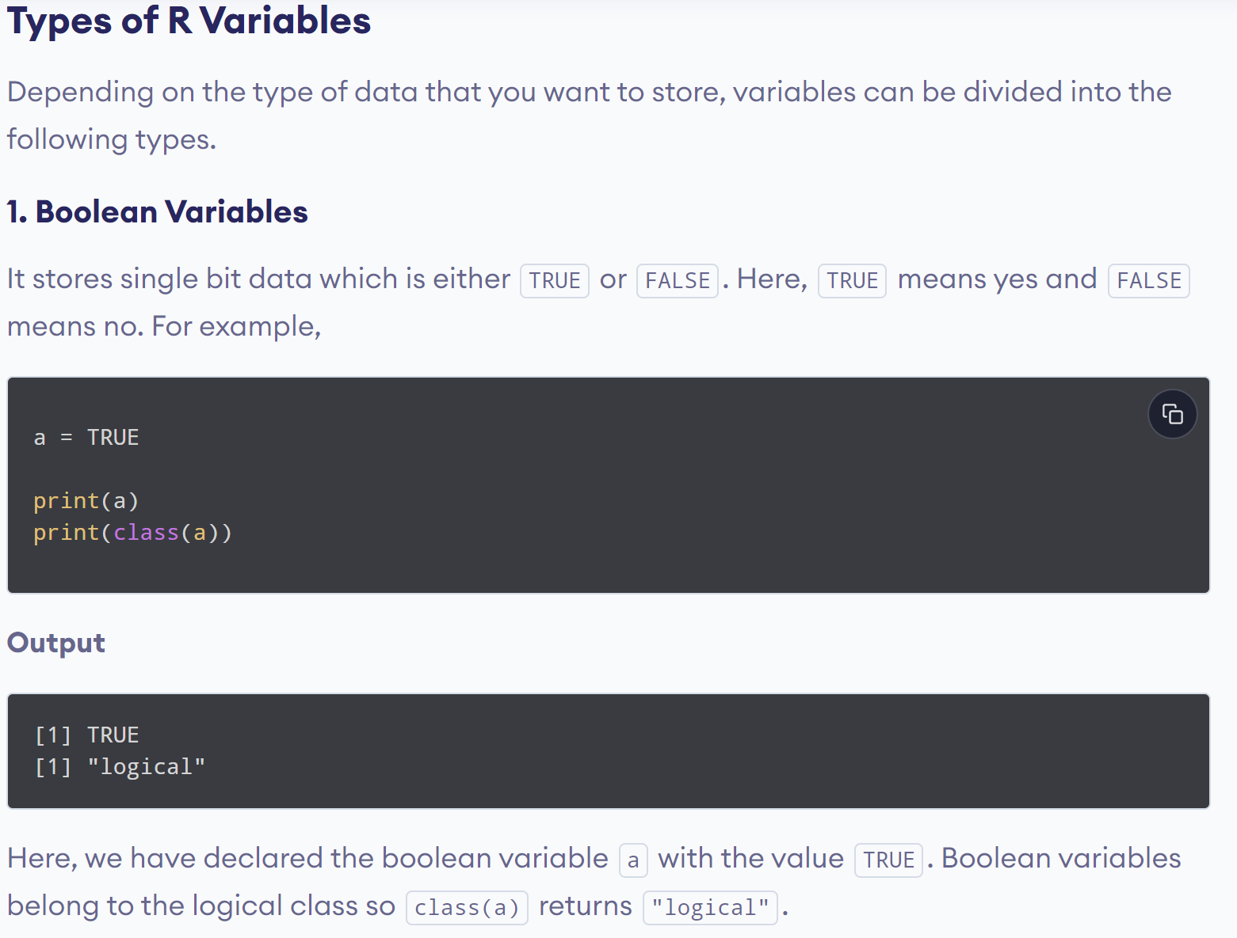
www.lpu.in Lovely Professional University
10

Slide 11
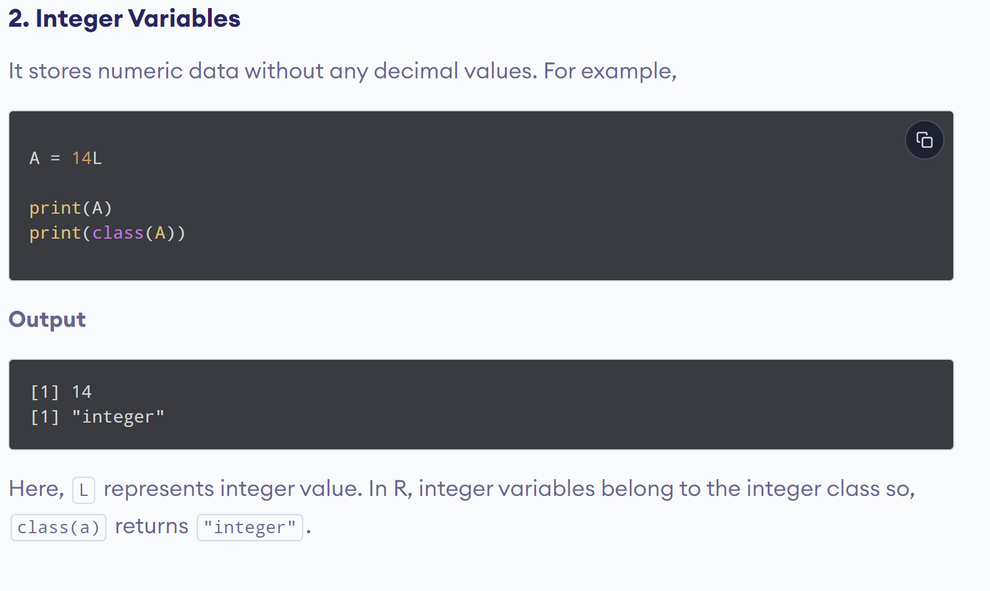
www.lpu.in Lovely Professional University
11

Slide 12
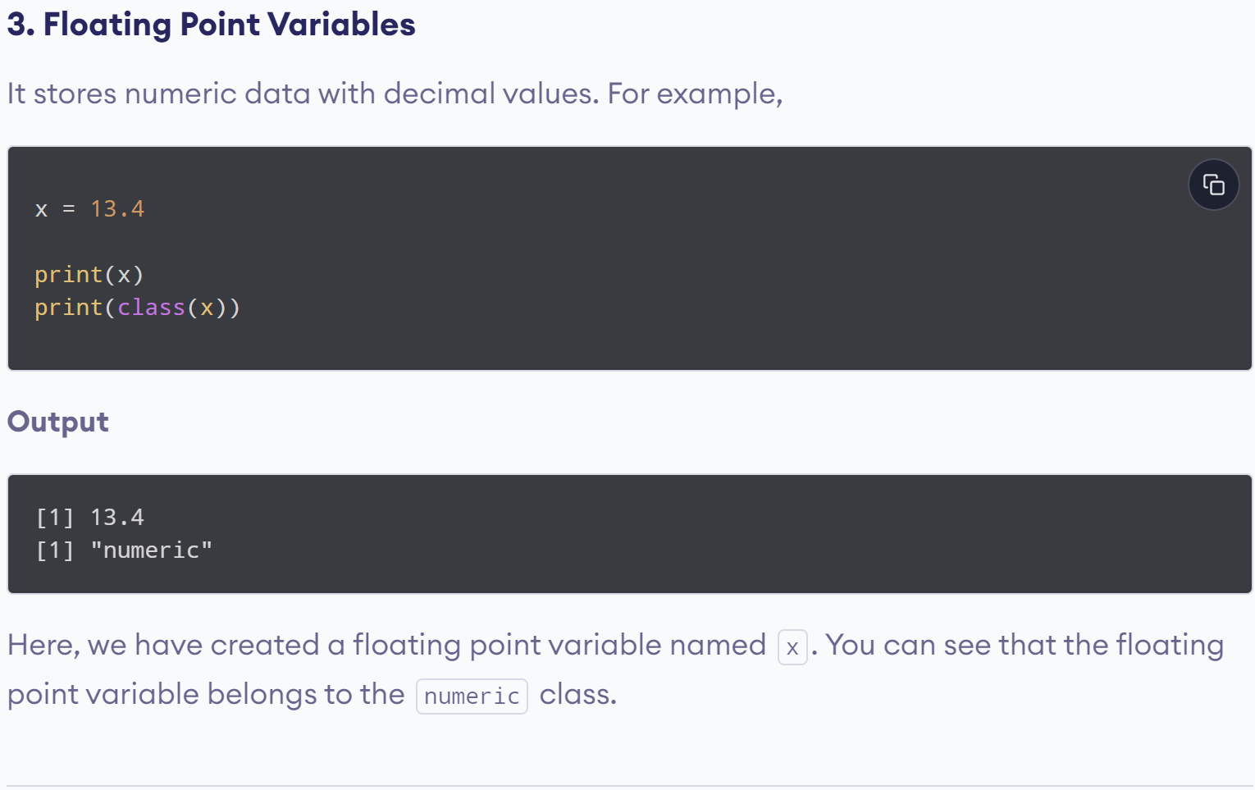
www.lpu.in Lovely Professional University
12

Slide 13
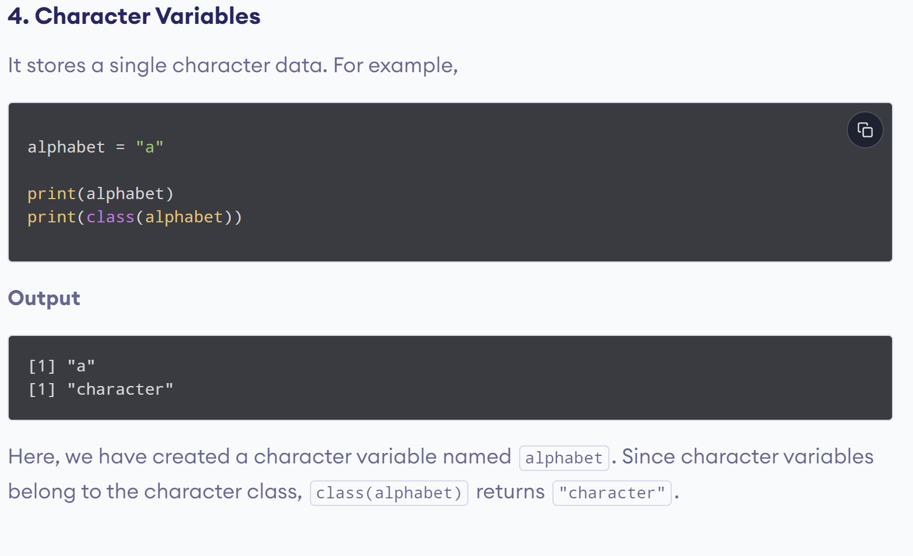
www.lpu.in Lovely Professional University
13

Slide 14
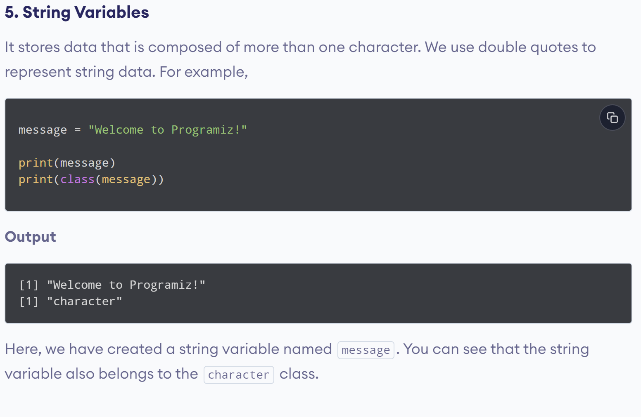
www.lpu.in Lovely Professional University
14

Slide 15
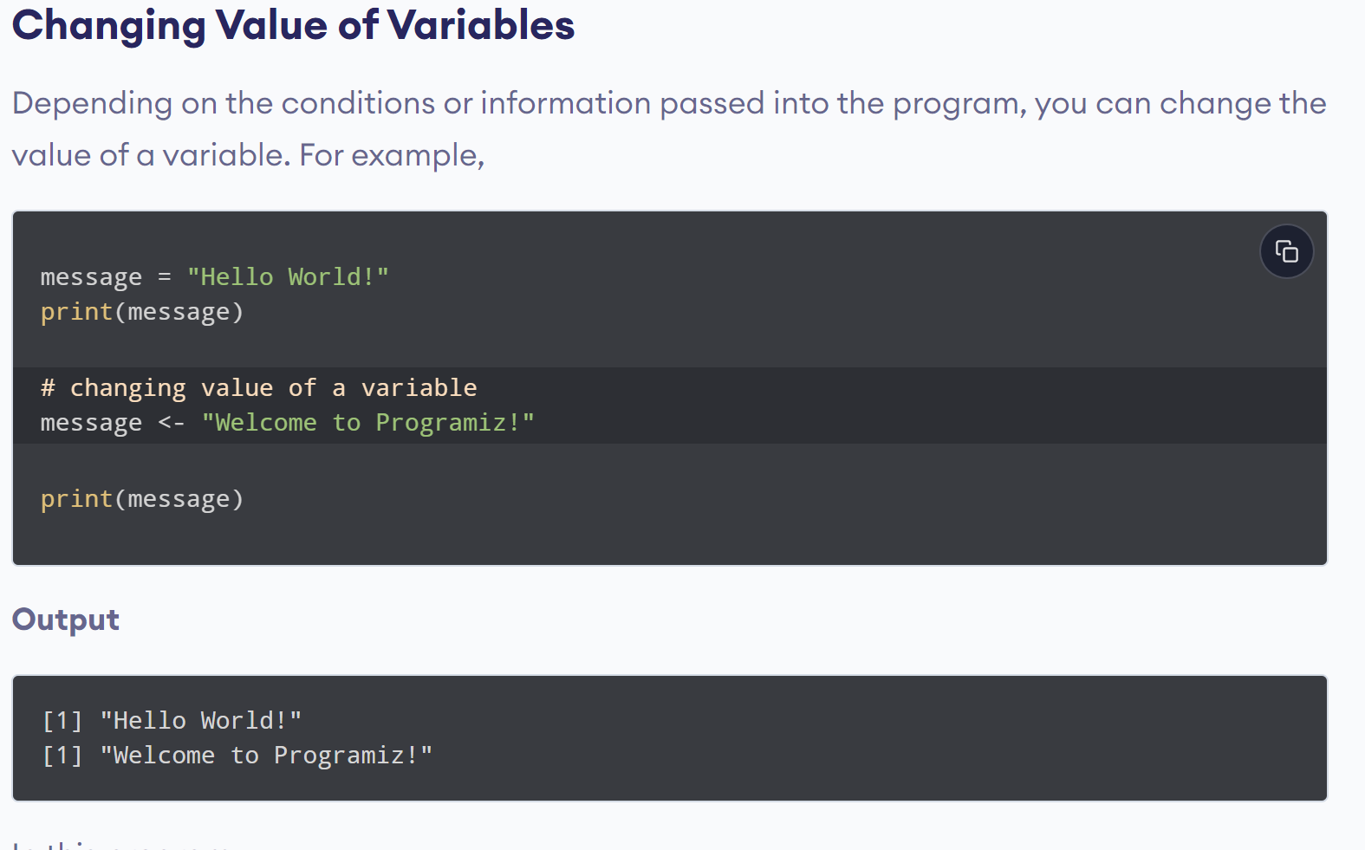
www.lpu.in Lovely Professional University
15

Slide 16
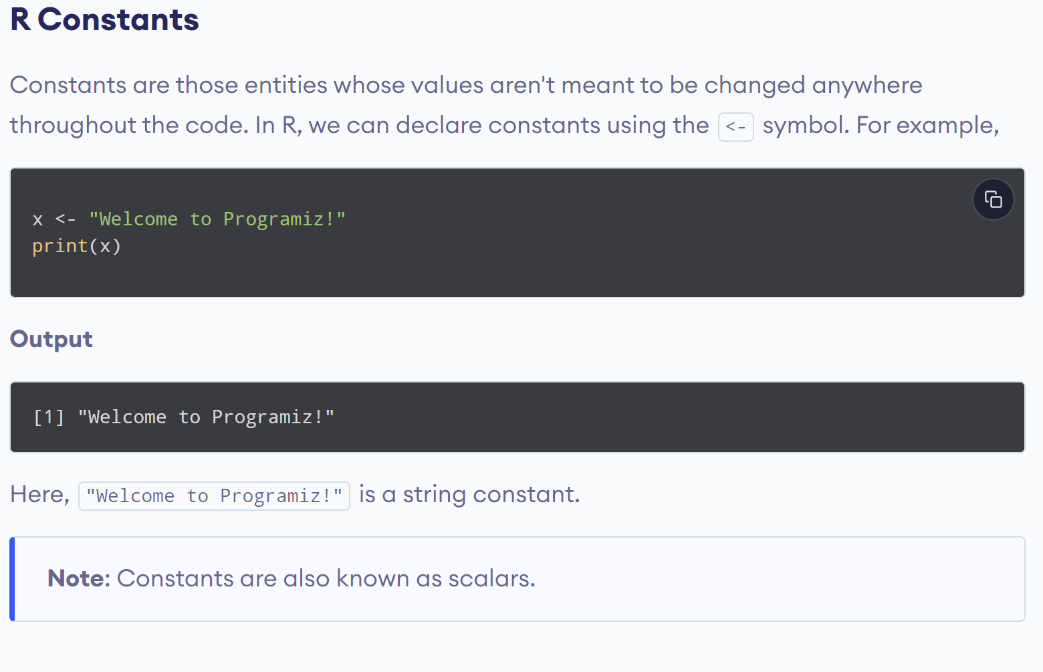
www.lpu.in Lovely Professional University
16

Slide 17
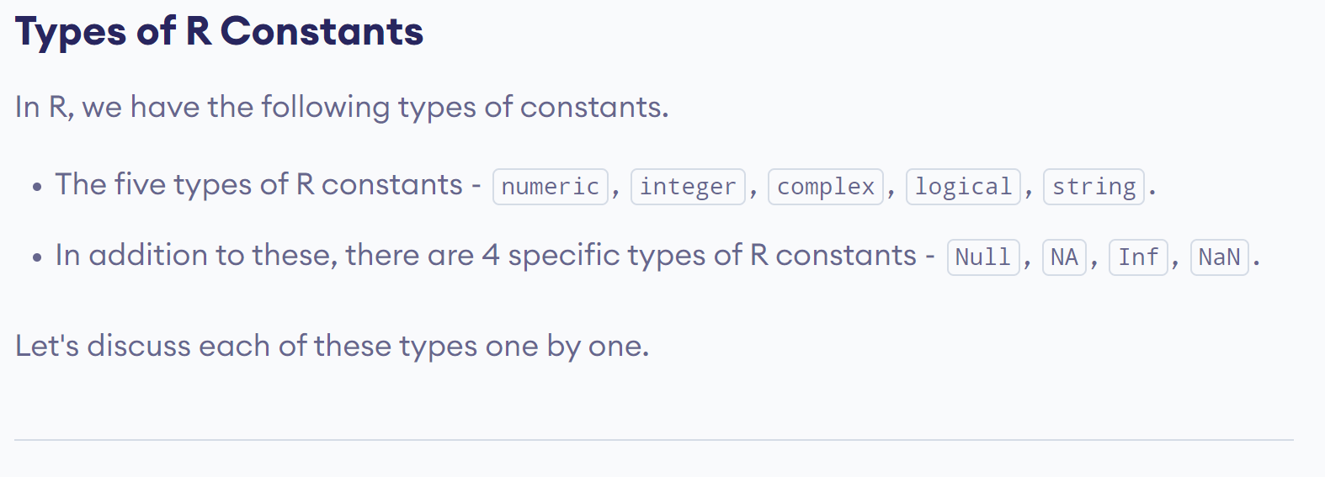
www.lpu.in Lovely Professional University
17

Slide 18
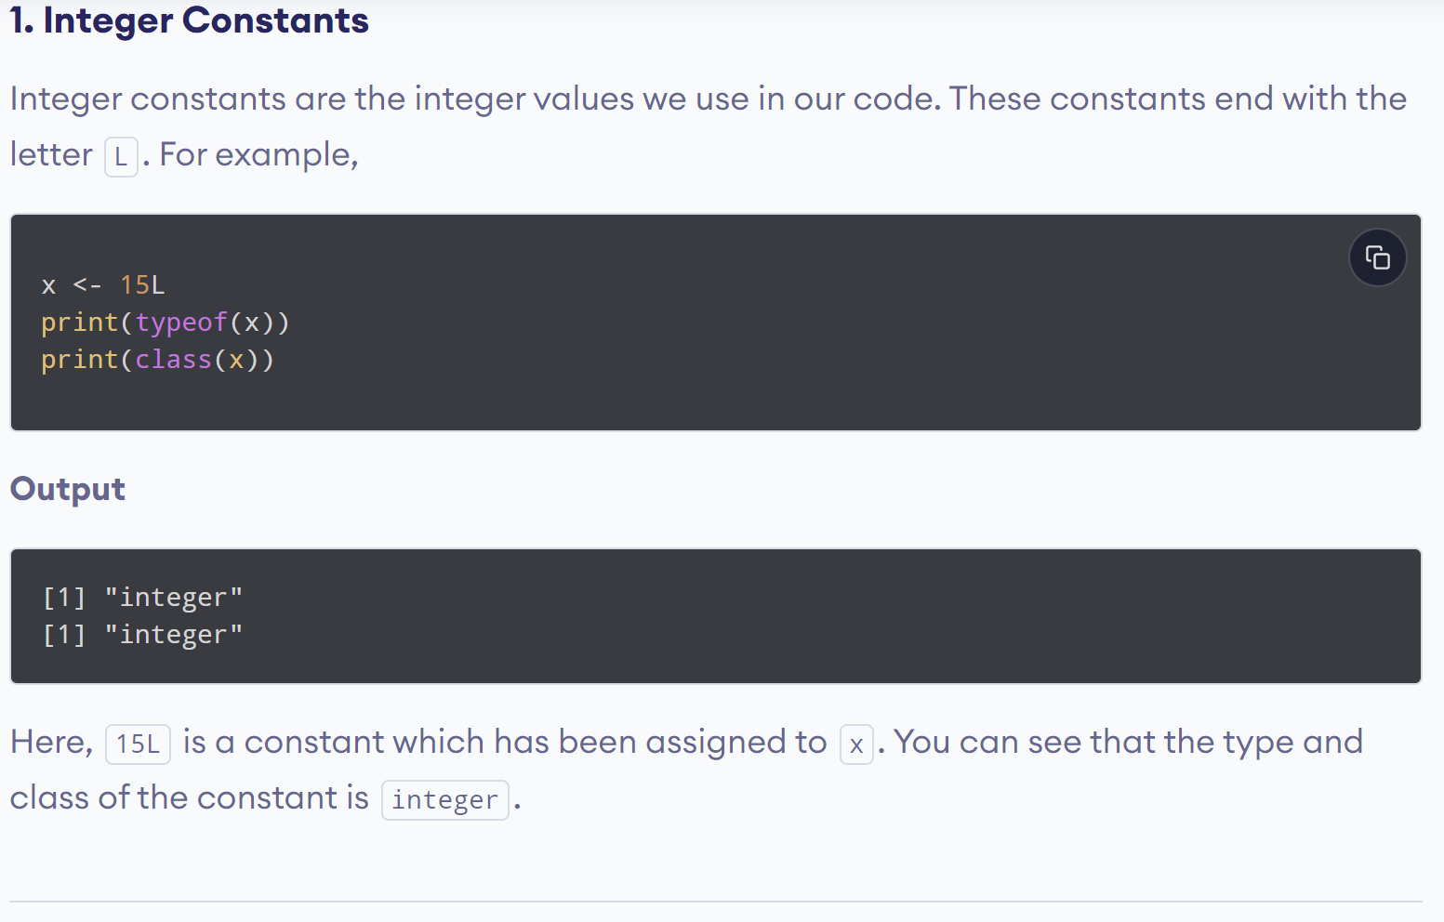
www.lpu.in Lovely Professional University
18

Slide 19
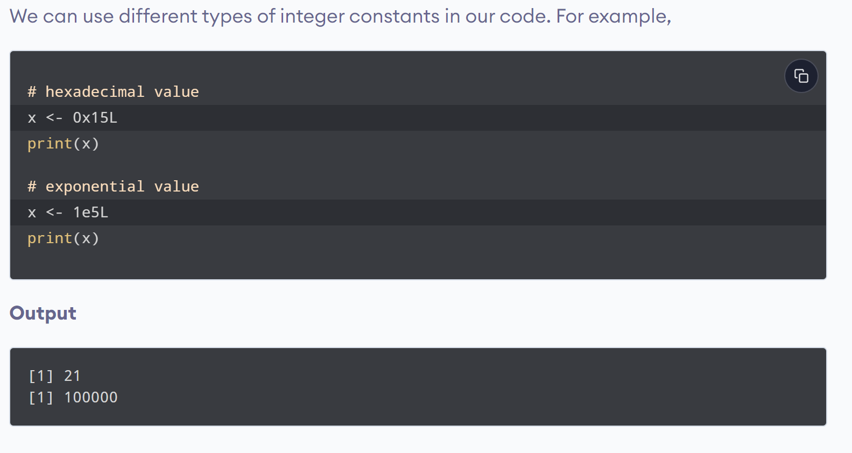
www.lpu.in Lovely Professional University
19

Slide 20
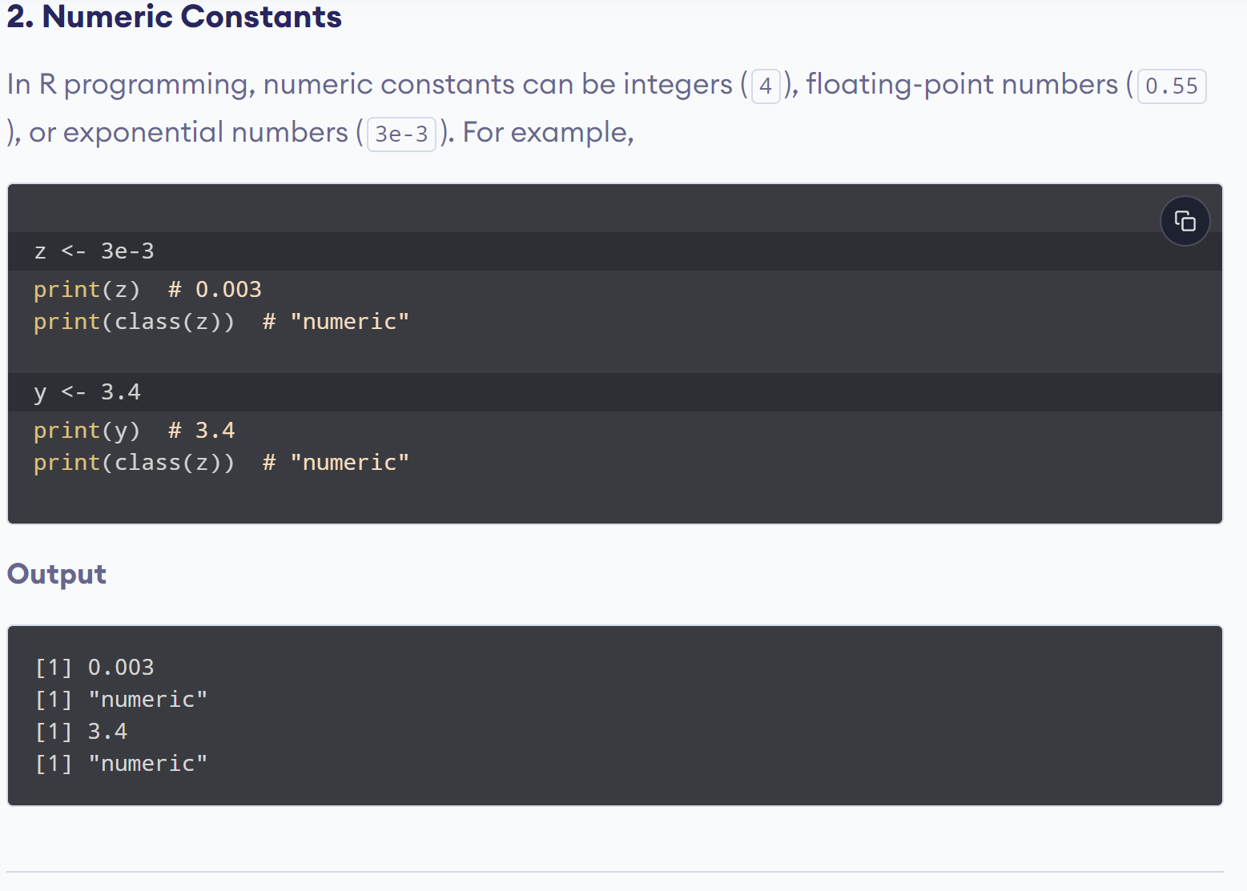
www.lpu.in Lovely Professional University
20

Slide 21
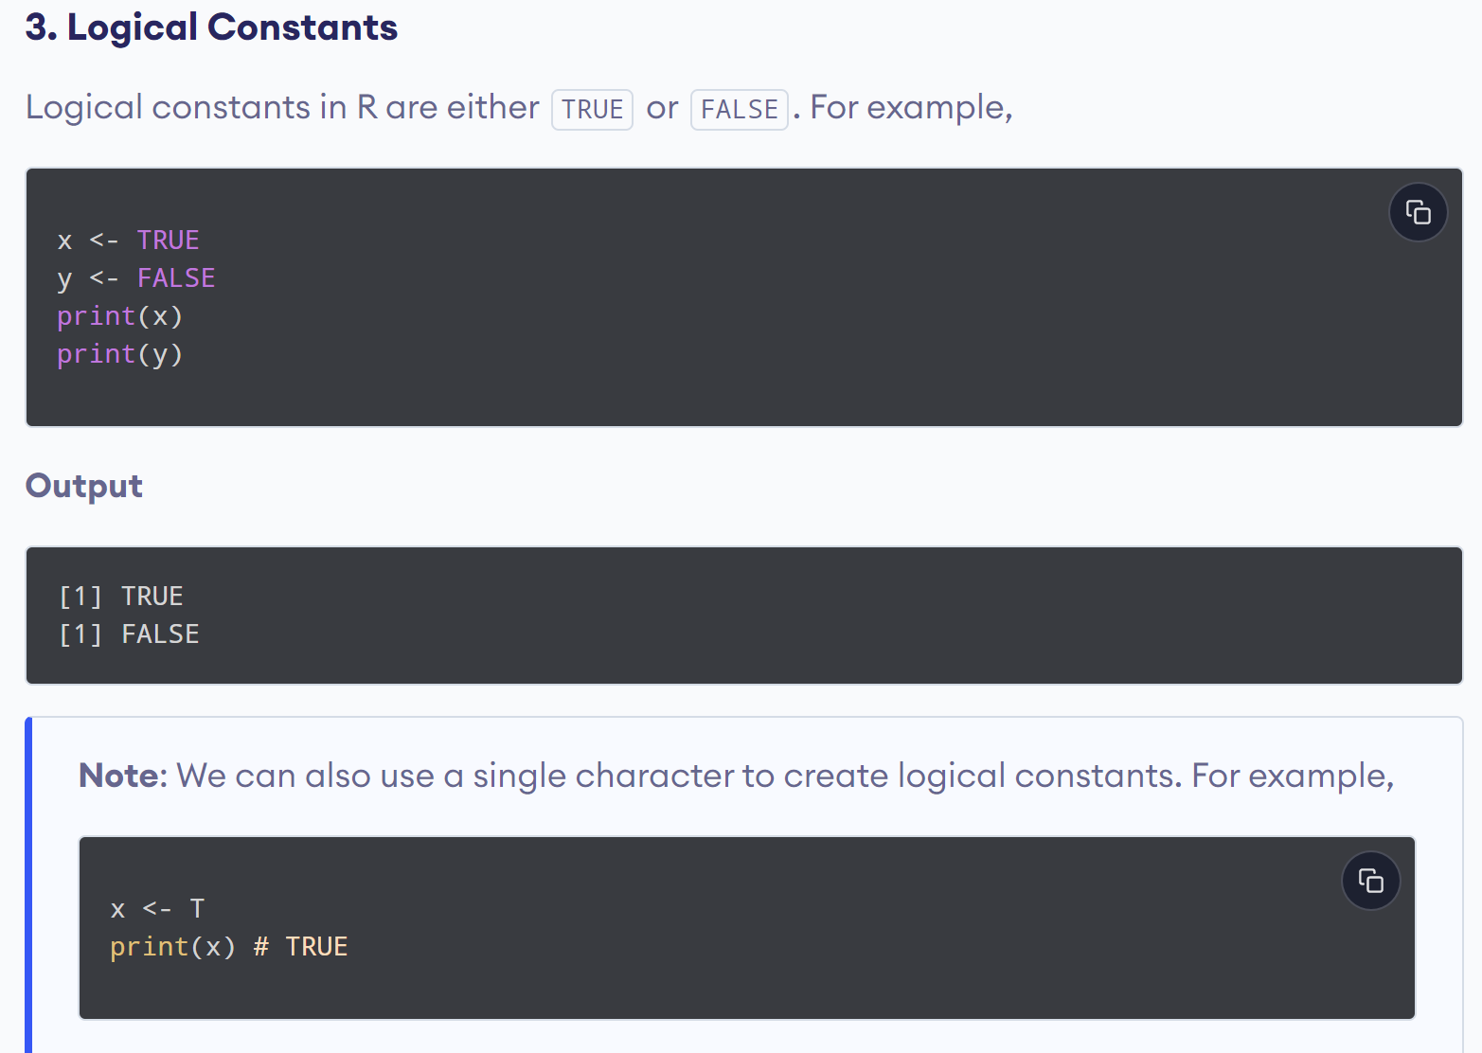
www.lpu.in Lovely Professional University
21

Slide 22
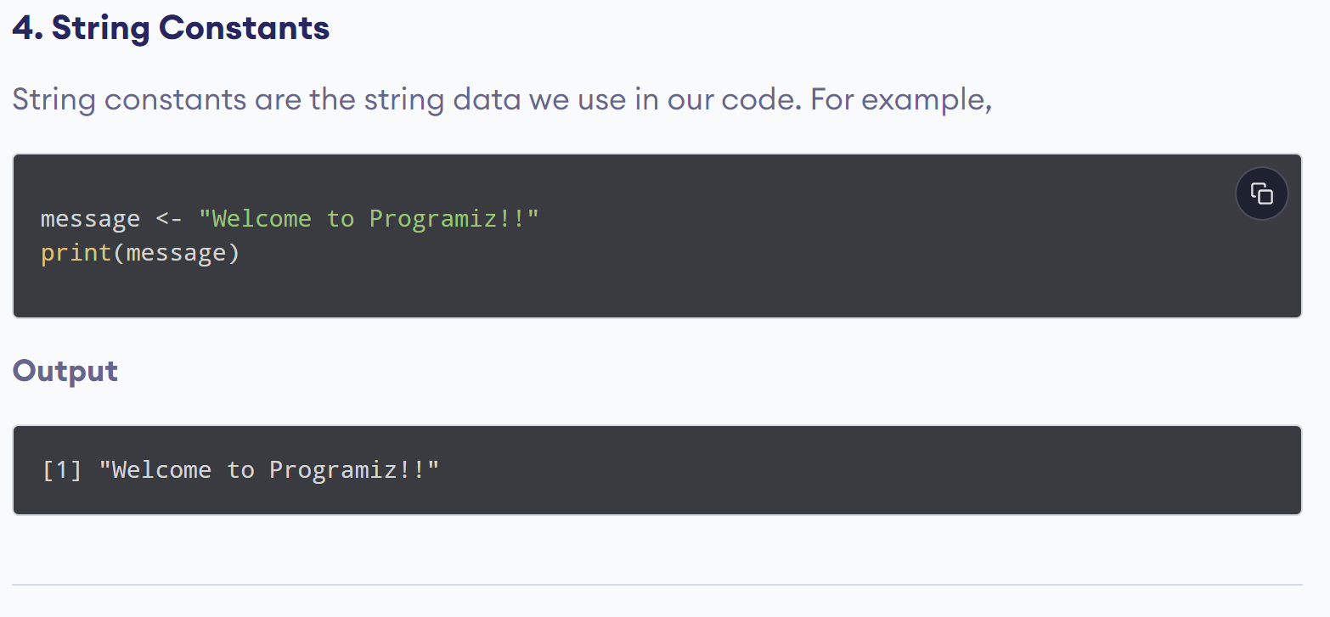
www.lpu.in Lovely Professional University
22

Slide 23
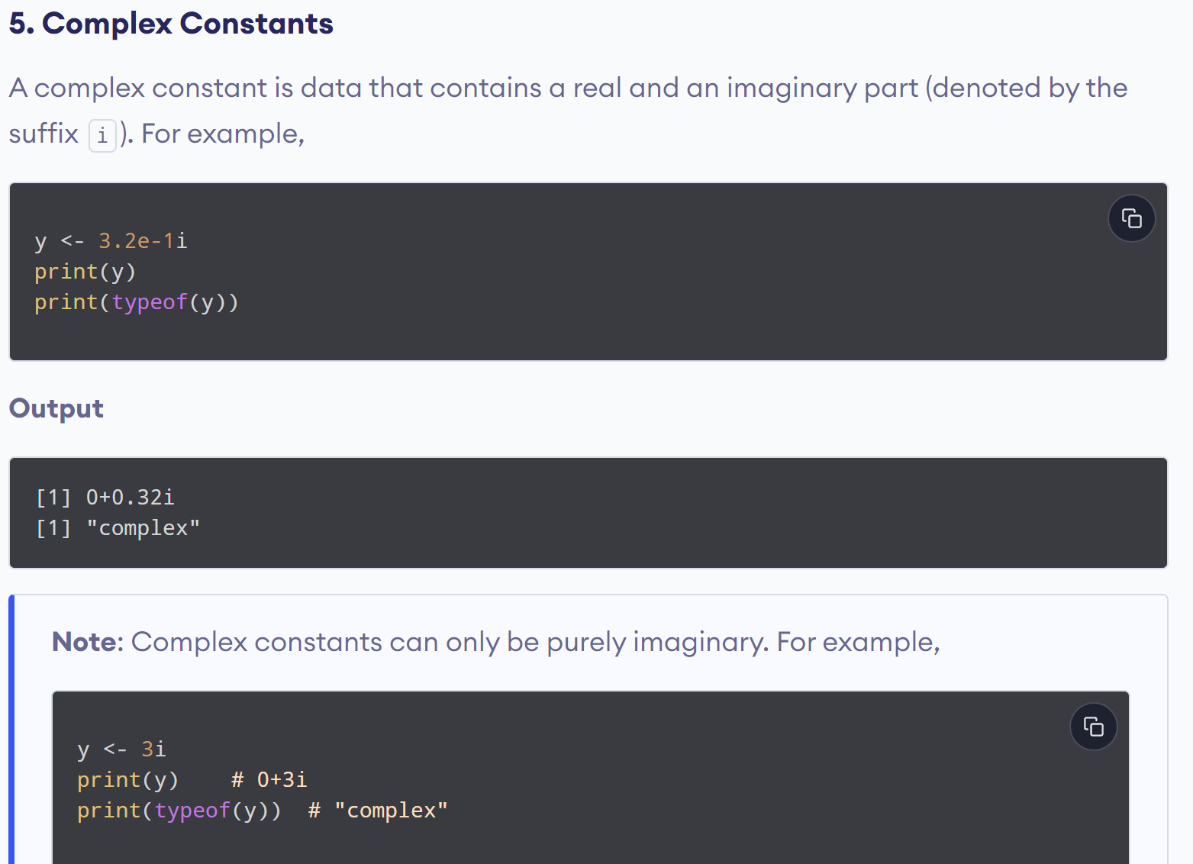
www.lpu.in Lovely Professional University
23

Slide 24
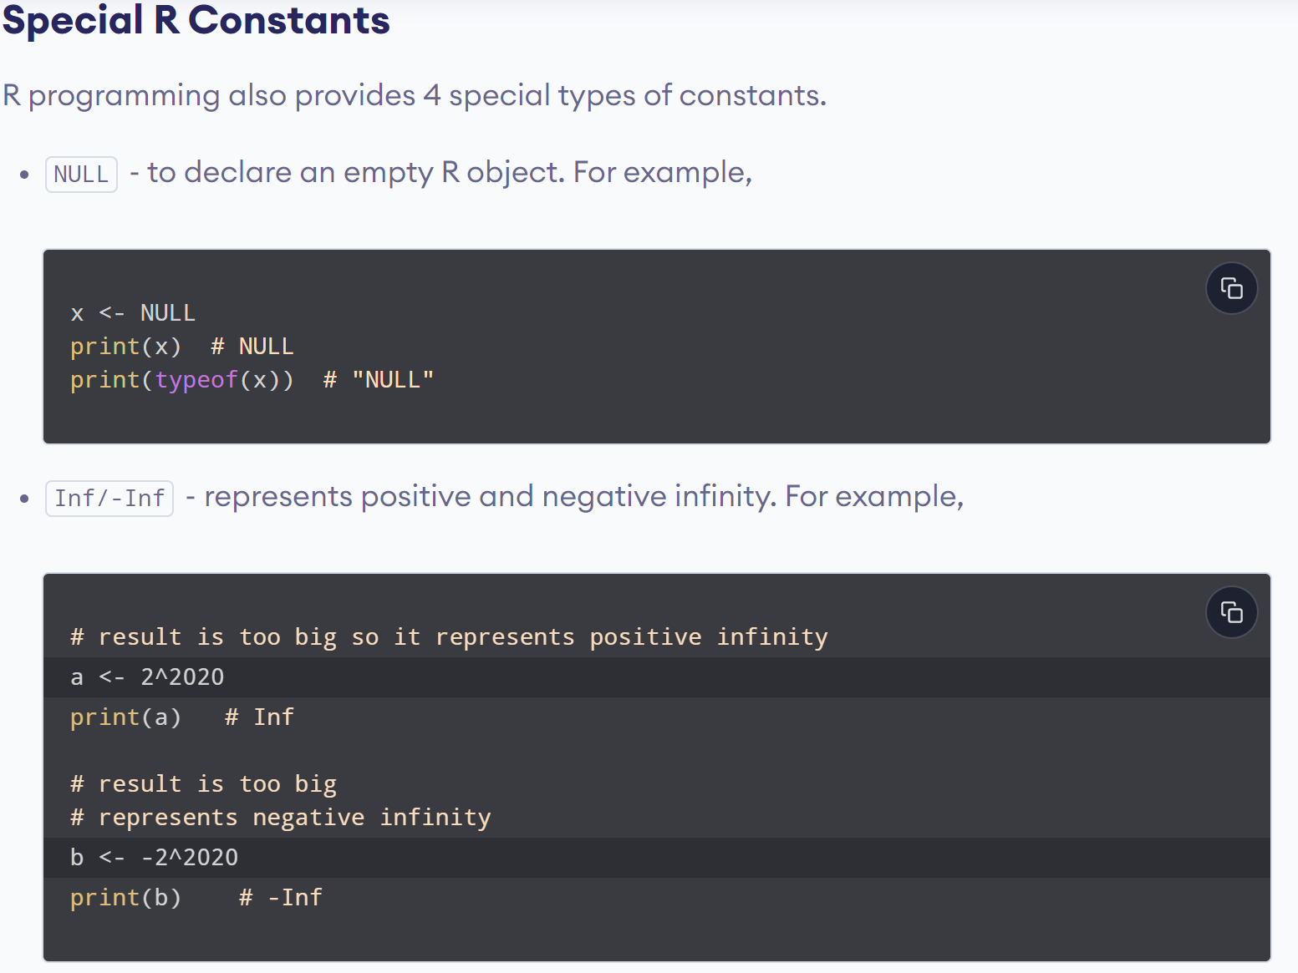
www.lpu.in Lovely Professional University
24

Slide 25
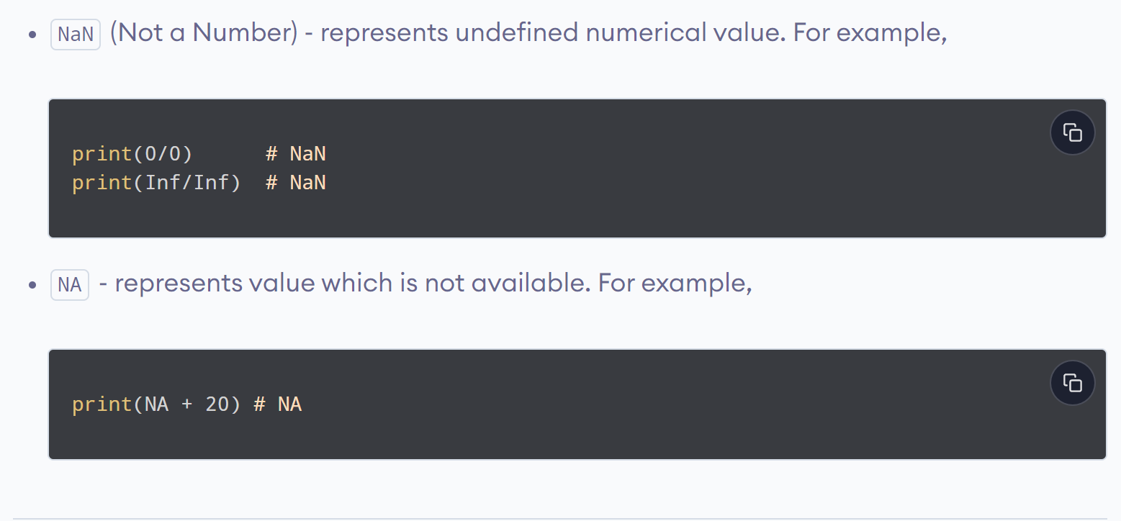
www.lpu.in Lovely Professional University
25

Slide 26
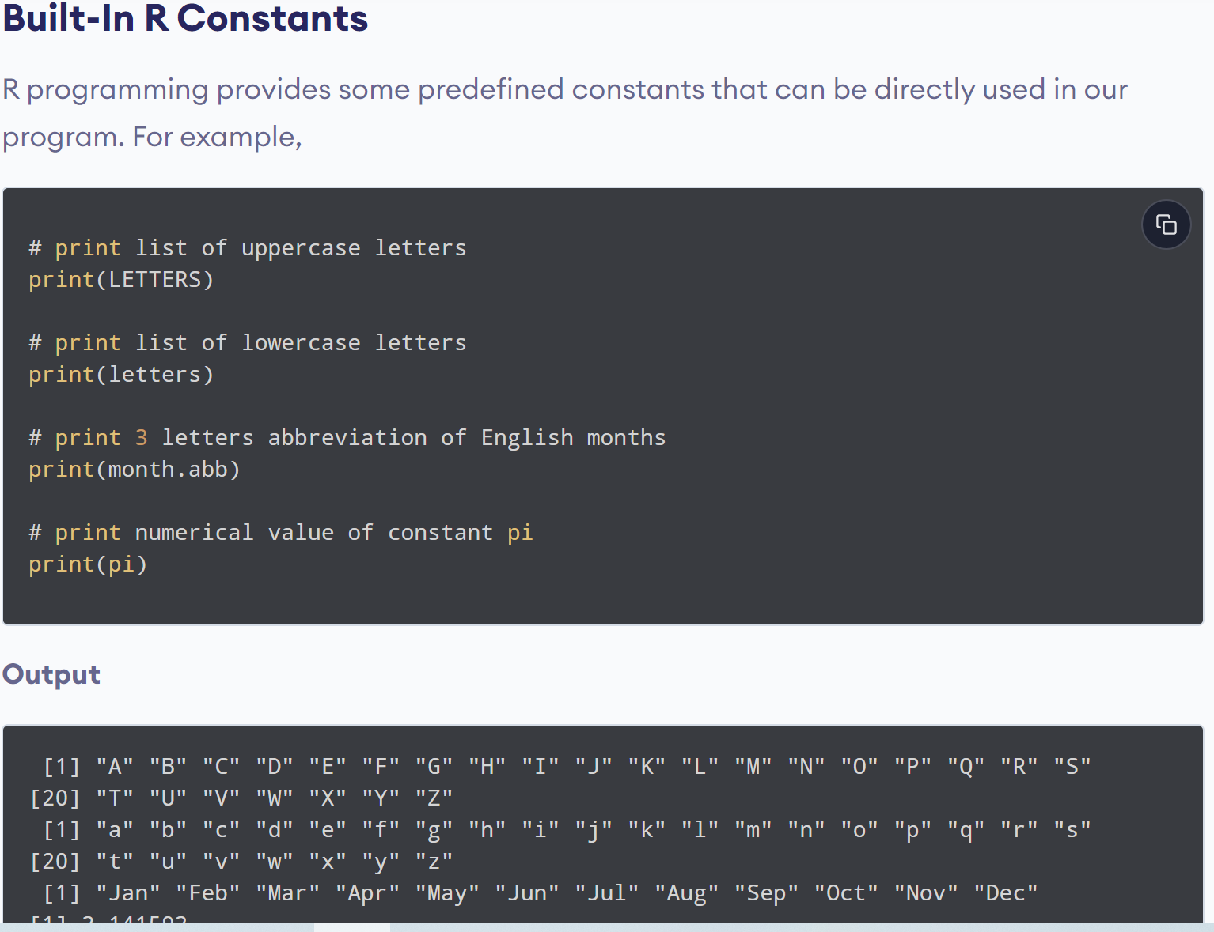
www.lpu.in Lovely Professional University
26

Slide 27
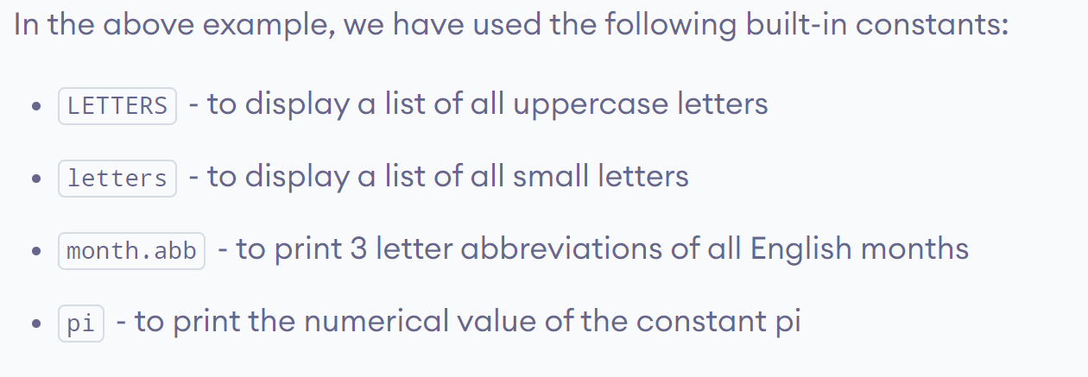
www.lpu.in Lovely Professional University
27

Slide 28

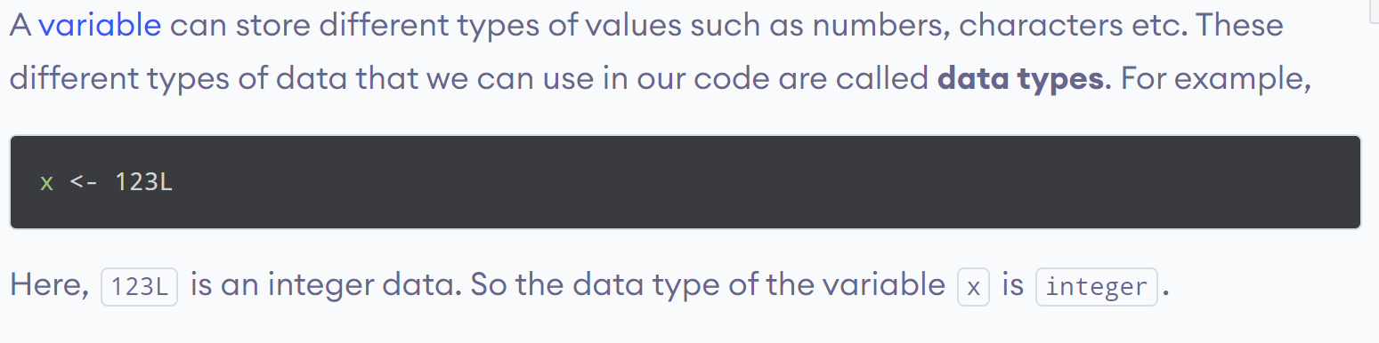
www.lpu.in Lovely Professional University
28

Slide 29
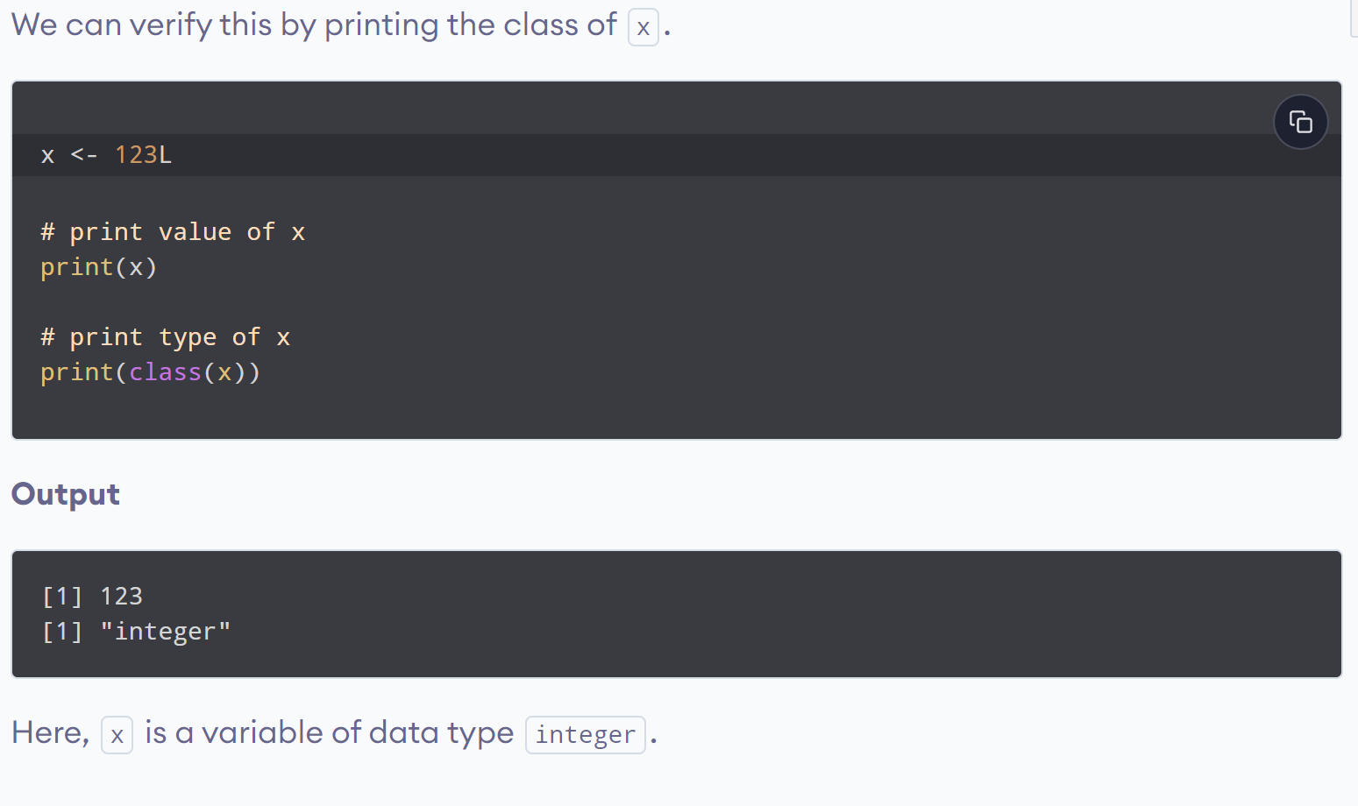
www.lpu.in Lovely Professional University
29

Slide 30
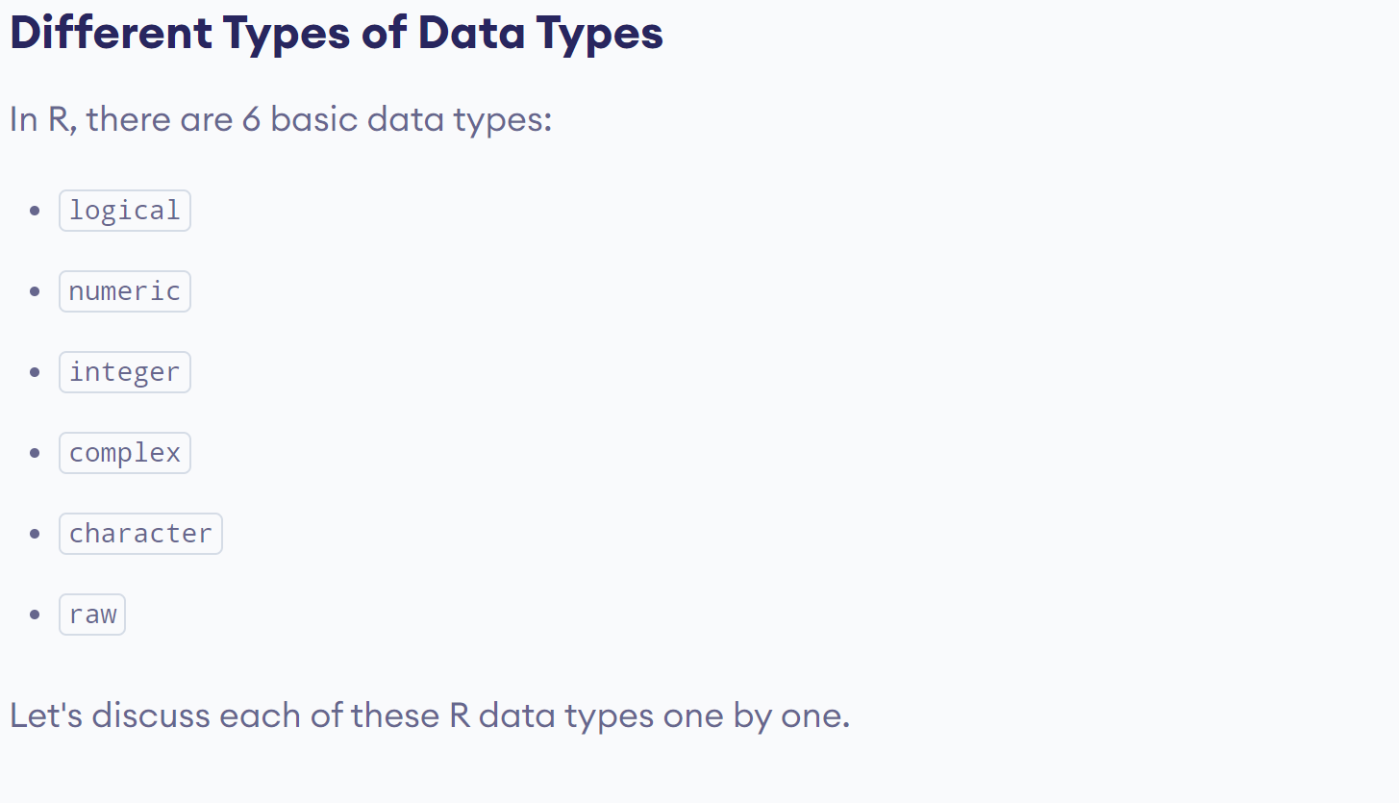
www.lpu.in Lovely Professional University
30

Slide 31
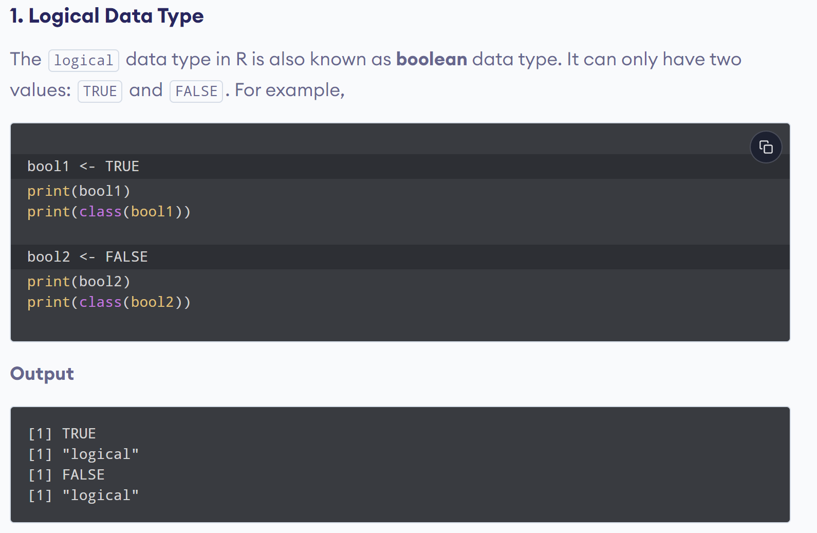
www.lpu.in Lovely Professional University
31

Slide 32
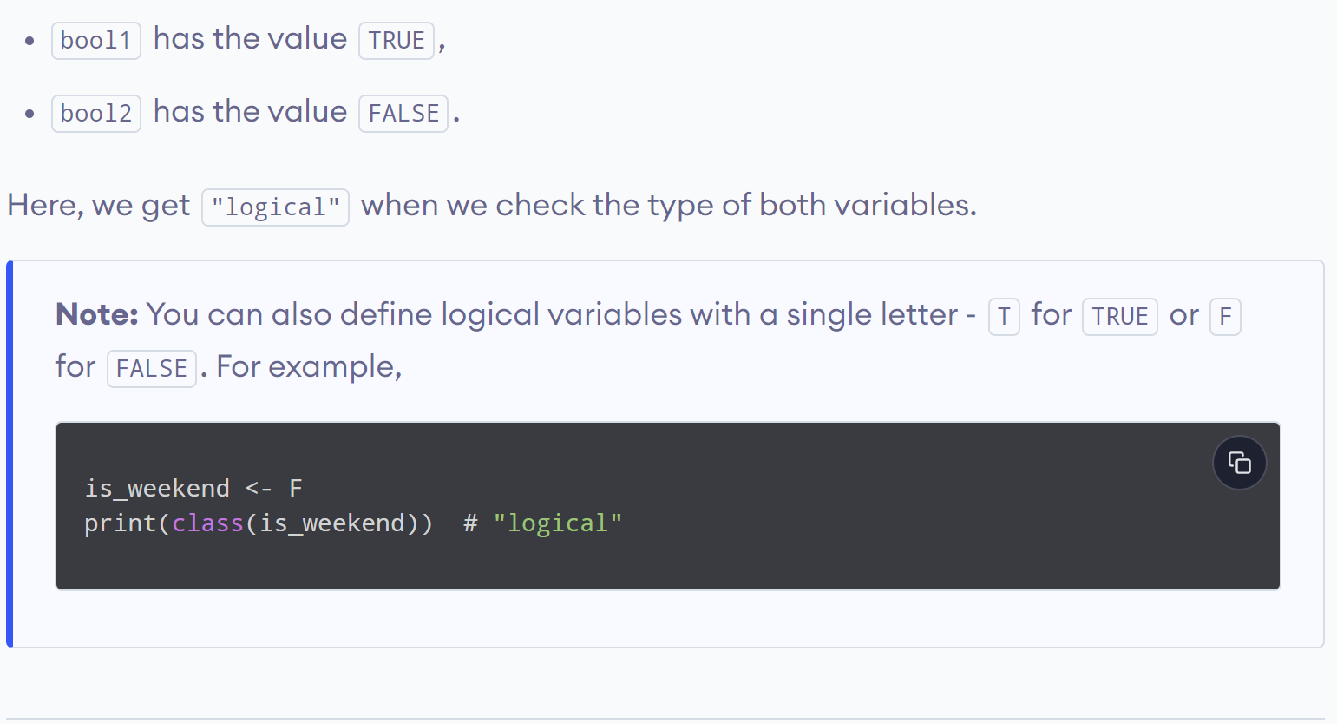
www.lpu.in Lovely Professional University
32

Slide 33
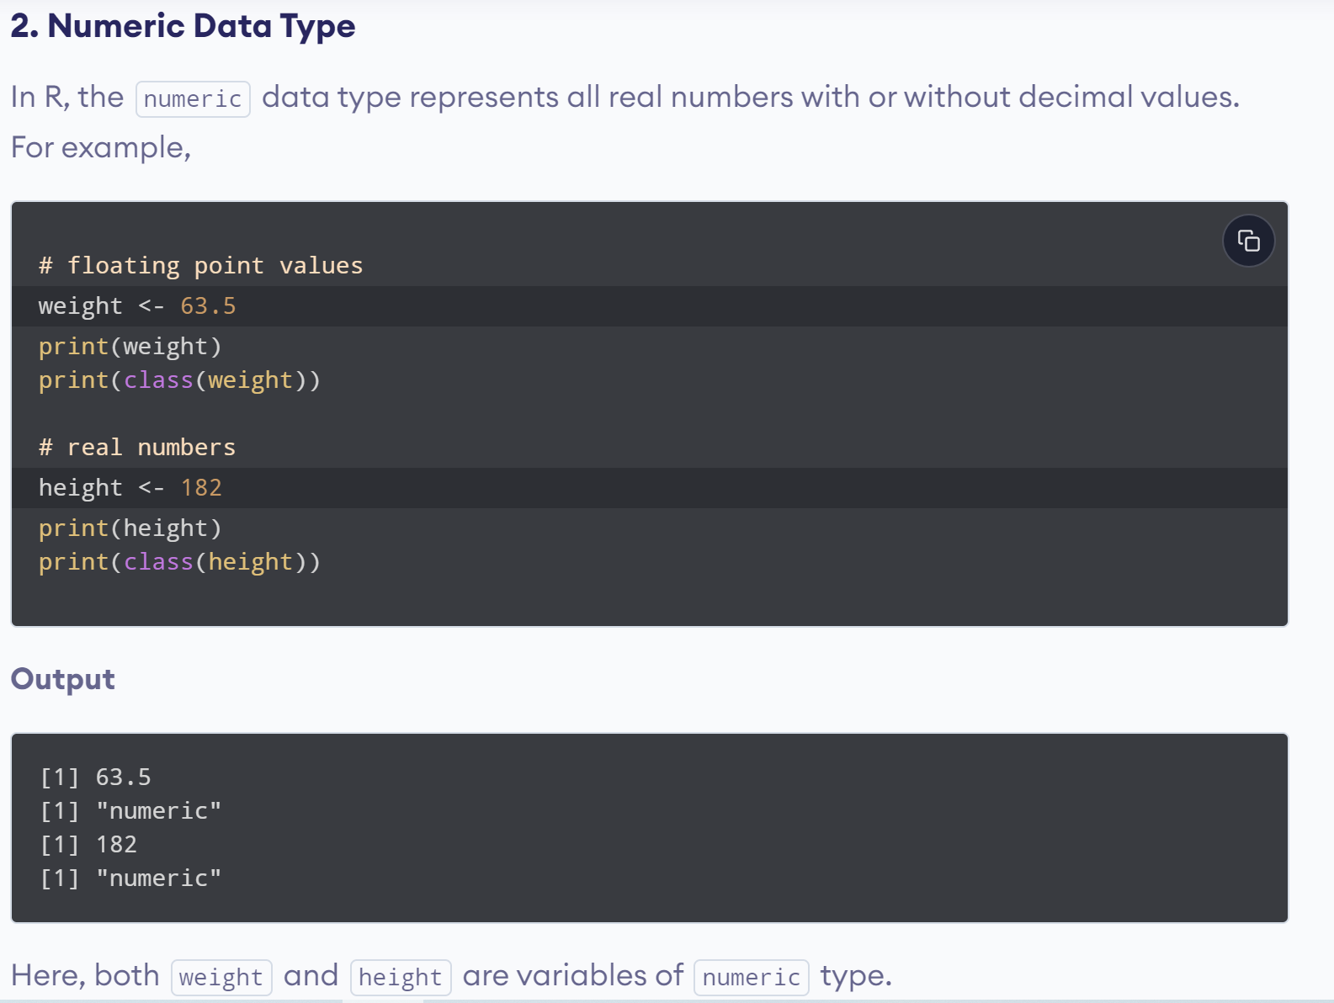
www.lpu.in Lovely Professional University
33

Slide 34
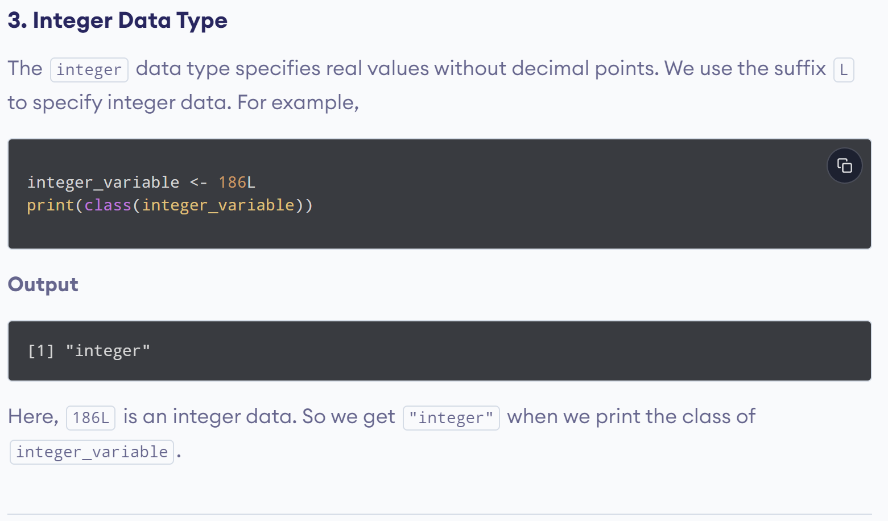
www.lpu.in Lovely Professional University
34

Slide 35
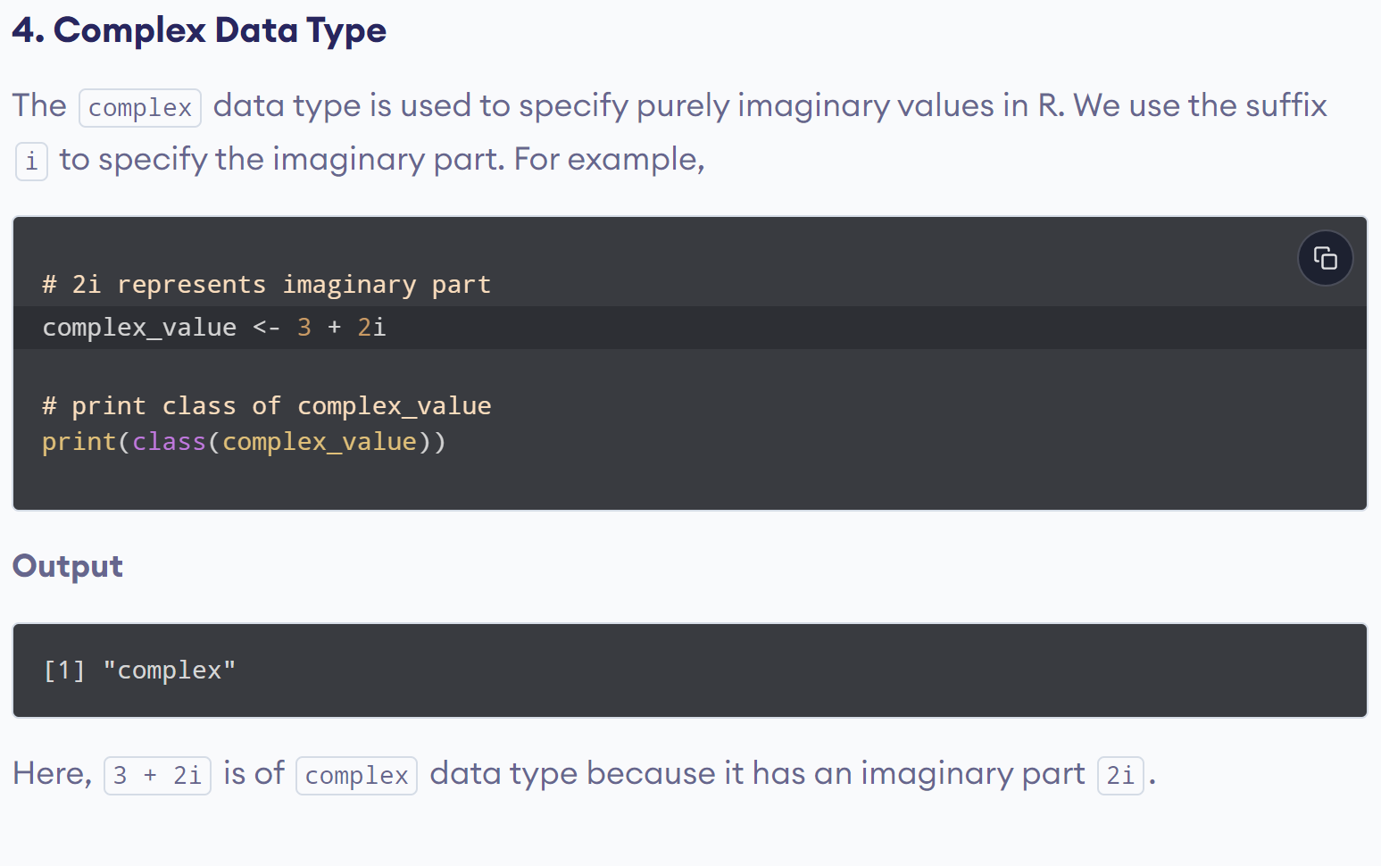
www.lpu.in Lovely Professional University
35

Slide 36
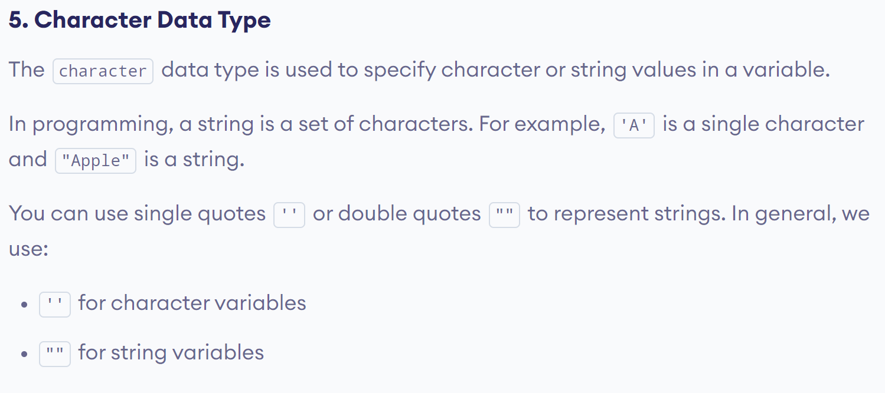
www.lpu.in Lovely Professional University
36

Slide 37
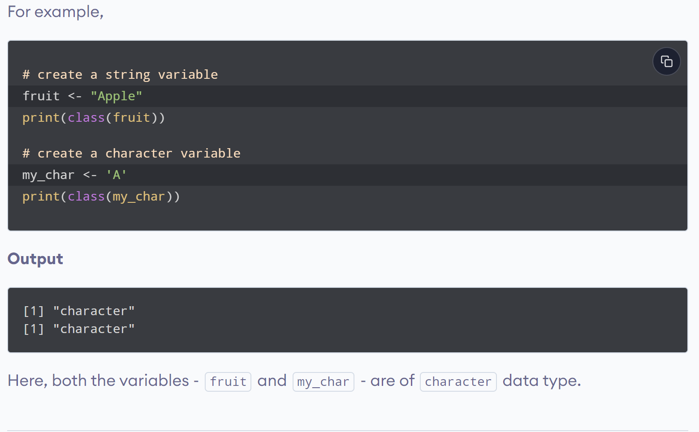
www.lpu.in Lovely Professional University
37

Slide 38
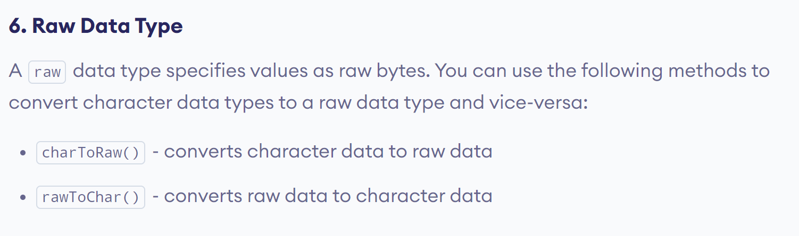
www.lpu.in Lovely Professional University
38

Slide 39
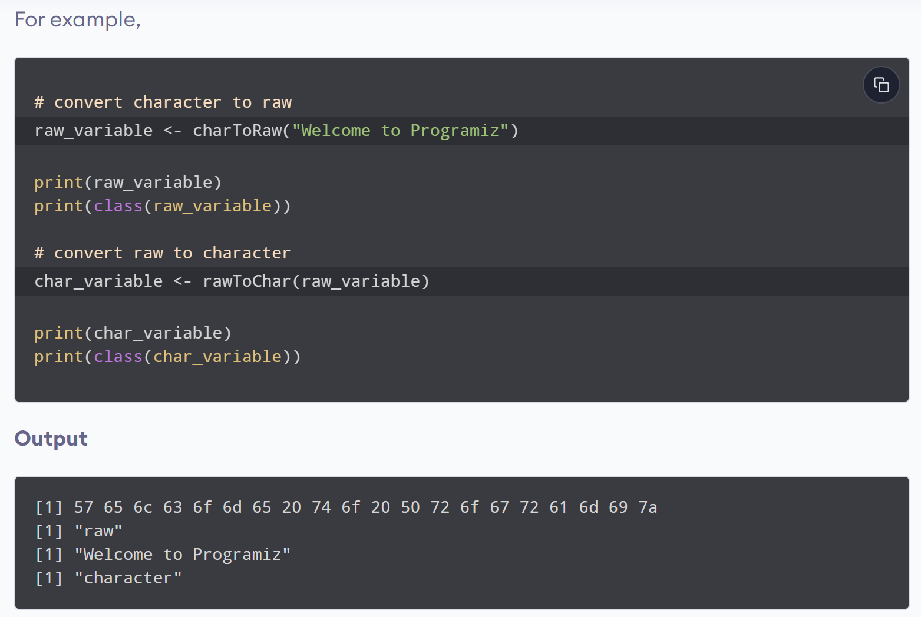
www.lpu.in Lovely Professional University
39

Slide 40
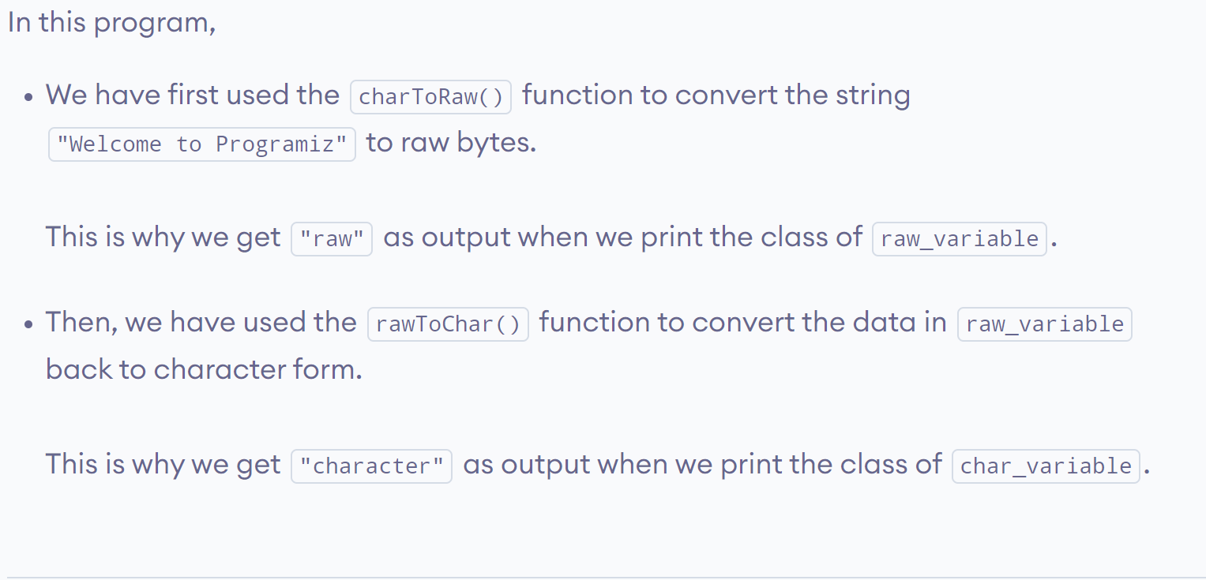
www.lpu.in Lovely Professional University
40

Slide 41

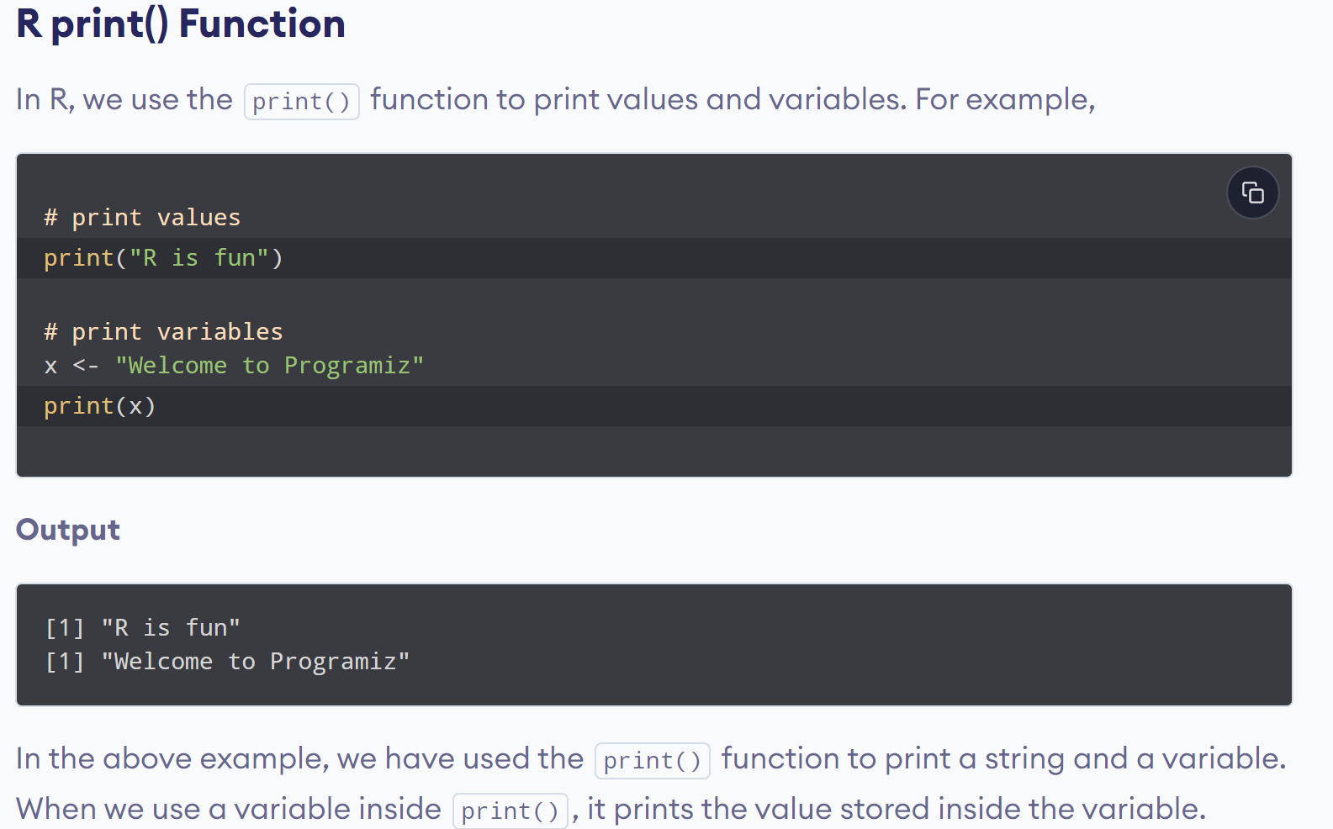
www.lpu.in Lovely Professional University
41

Slide 42
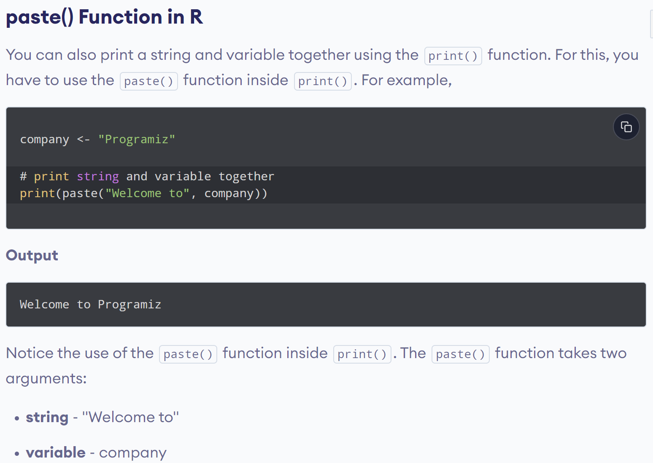
www.lpu.in Lovely Professional University
42

Slide 43
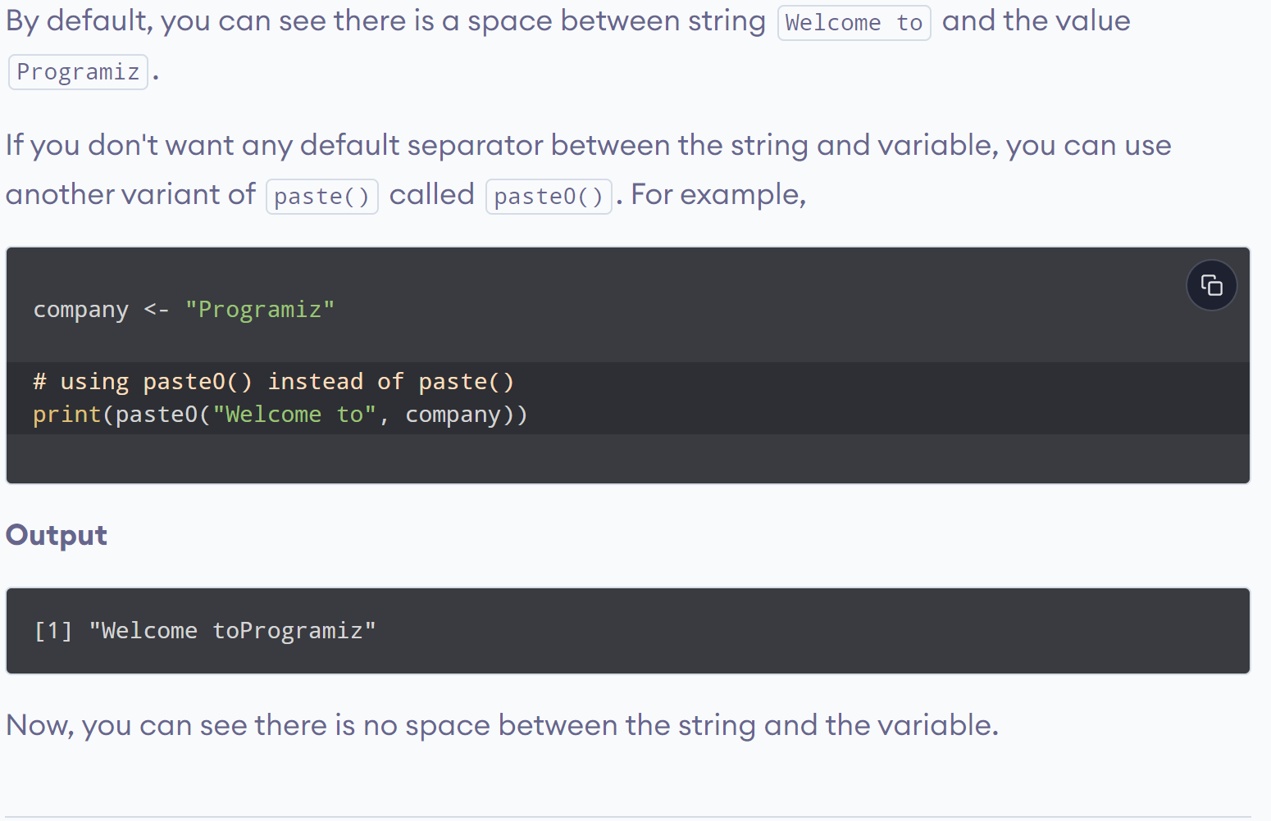
www.lpu.in Lovely Professional University
43

Slide 44
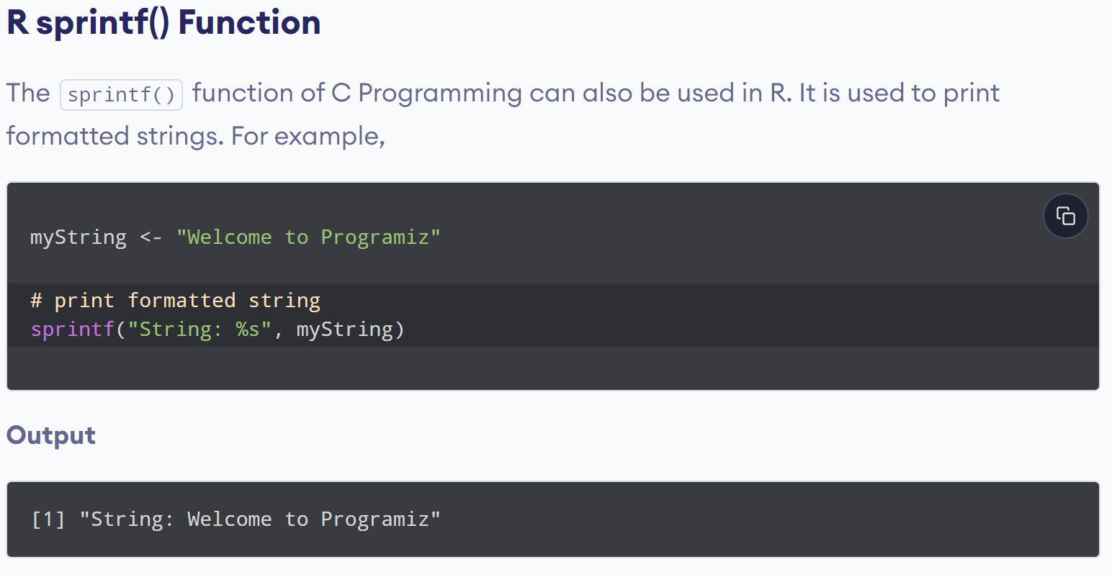
www.lpu.in Lovely Professional University
44

Slide 45
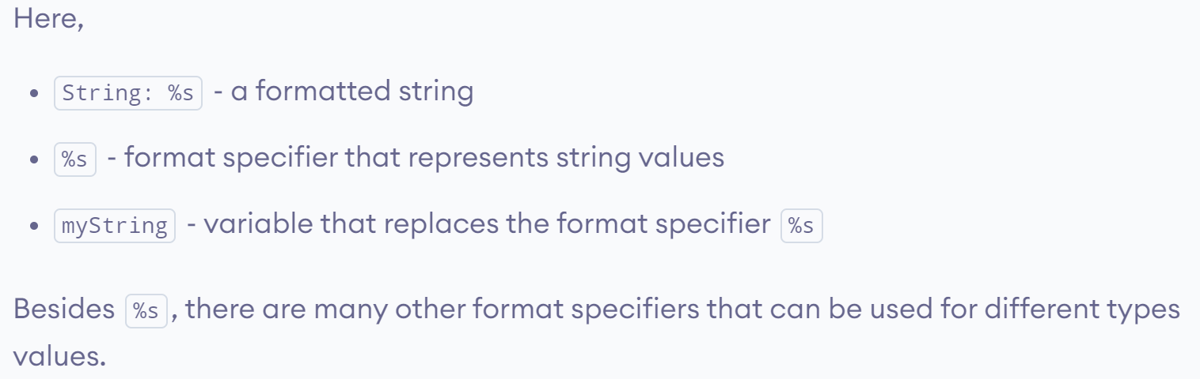
www.lpu.in Lovely Professional University
45

Slide 46
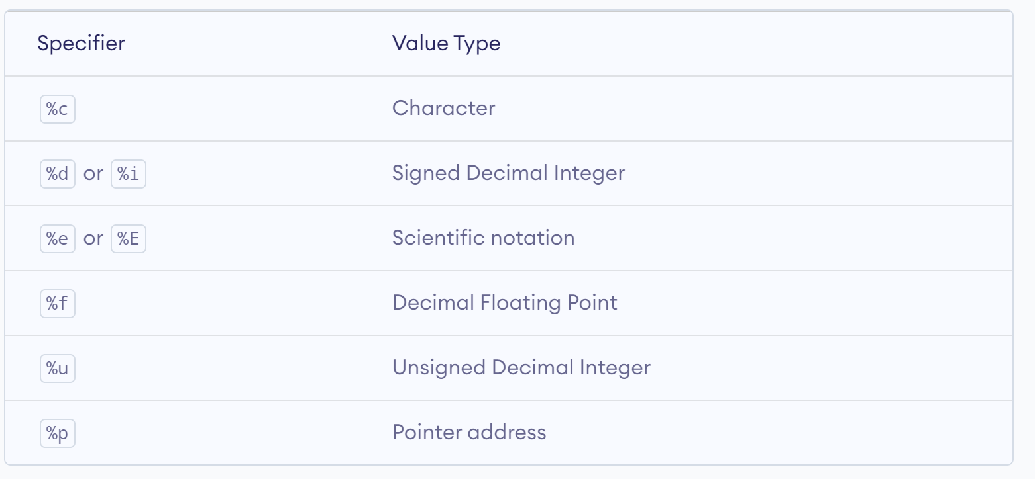
www.lpu.in Lovely Professional University
46

Slide 47
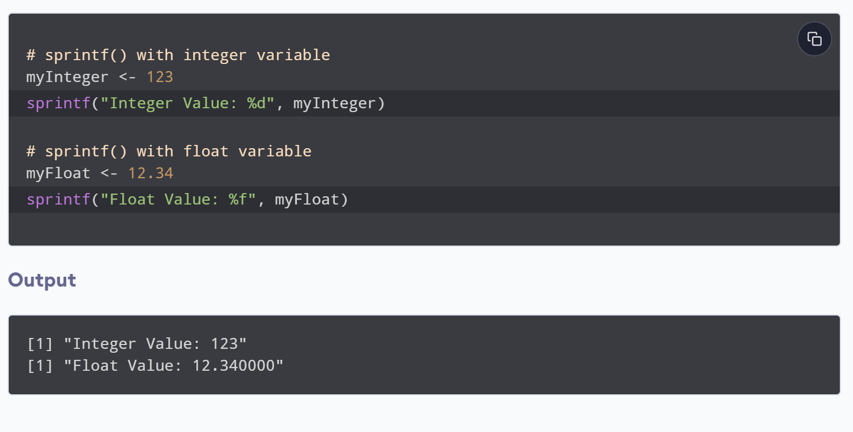
www.lpu.in Lovely Professional University
47

Slide 48
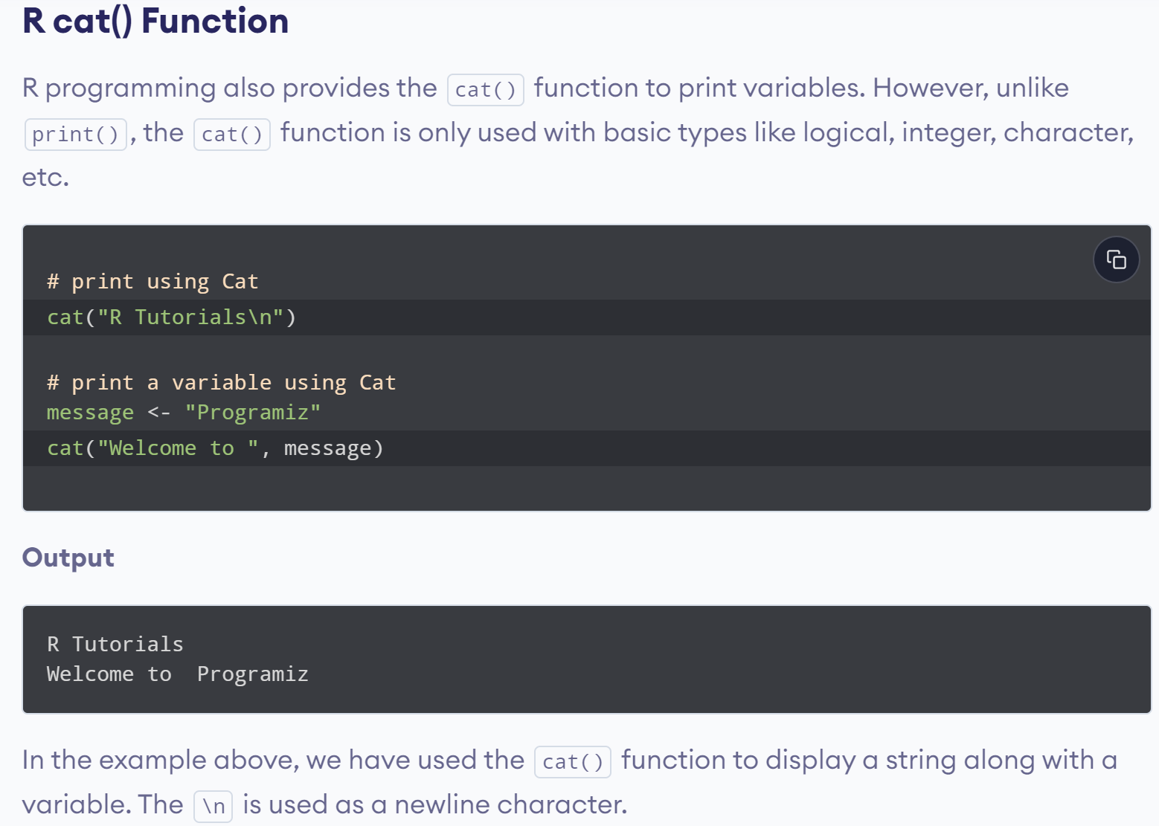
www.lpu.in Lovely Professional University
48

Slide 49

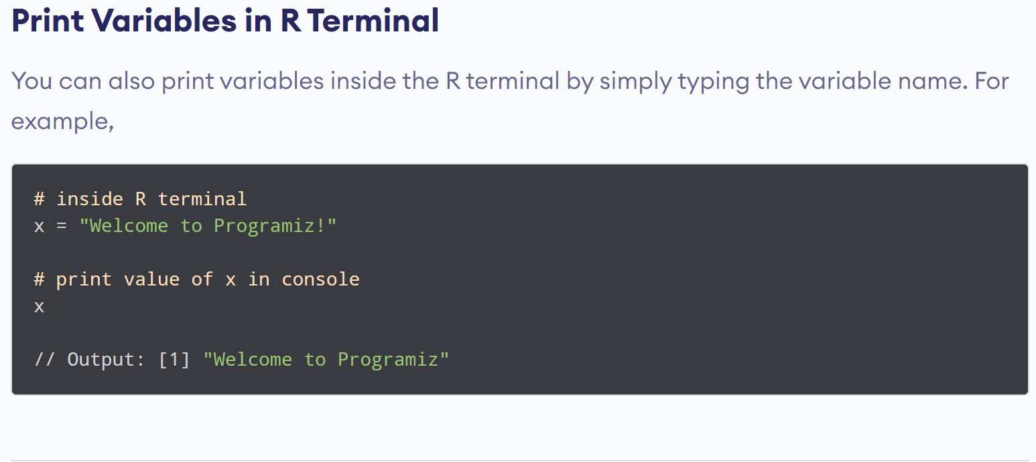
www.lpu.in Lovely Professional University
49

Slide 50

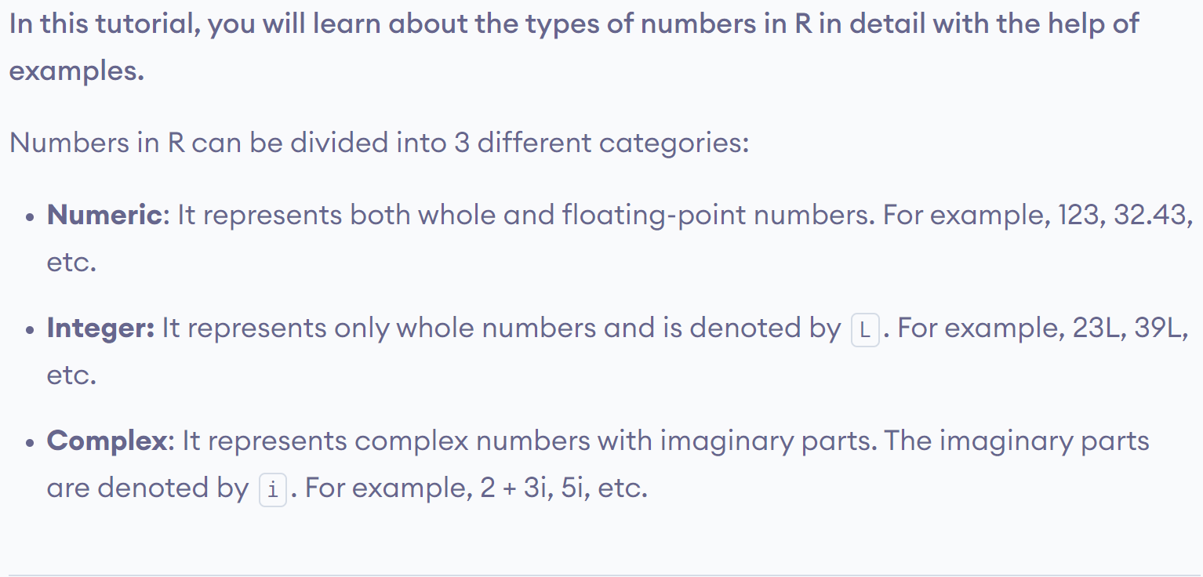
www.lpu.in Lovely Professional University
50

Slide 51
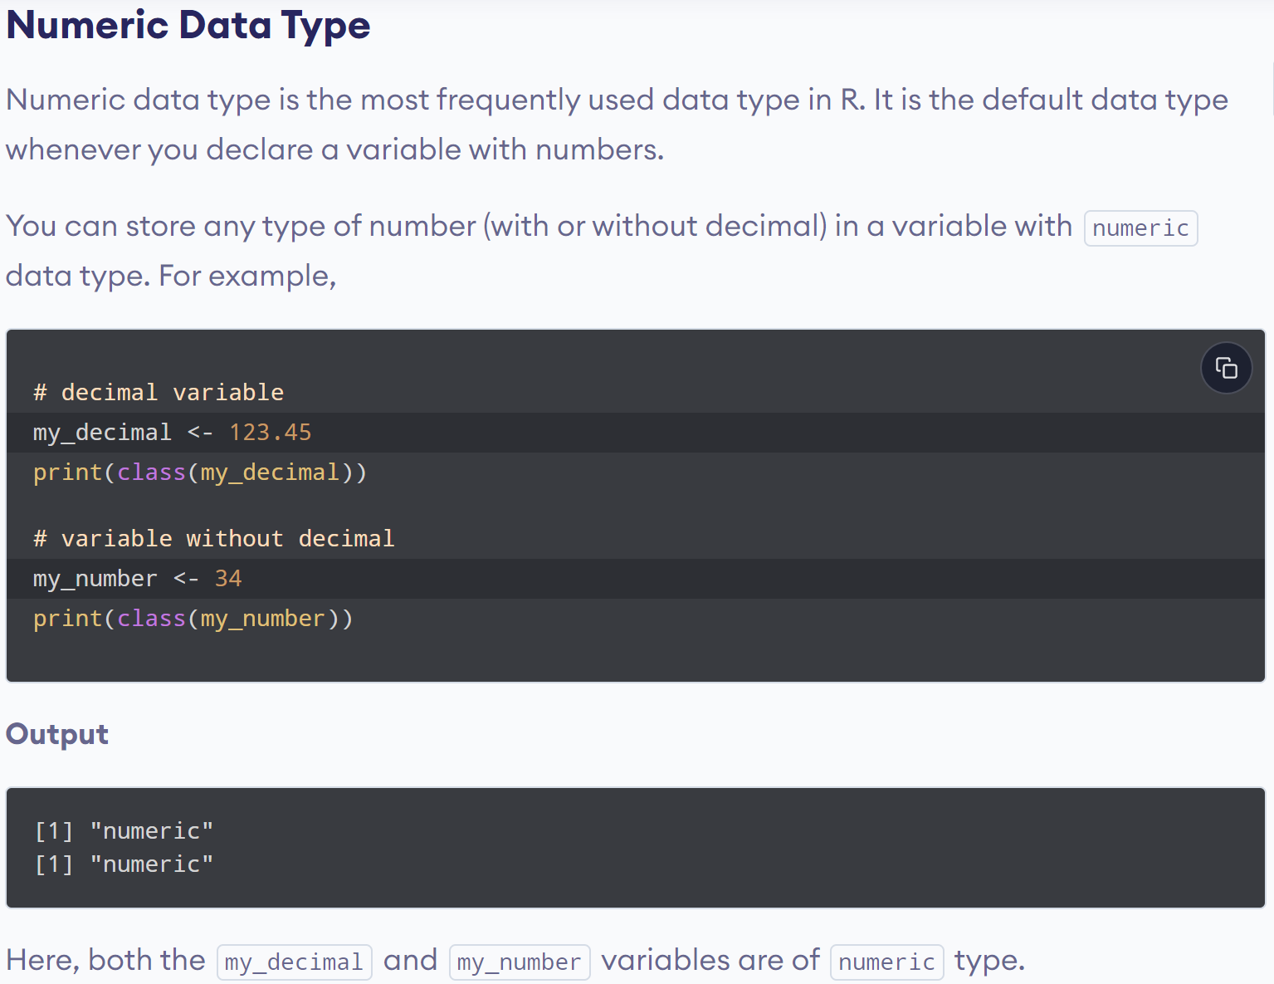
www.lpu.in Lovely Professional University
51

Slide 52


www.lpu.in Lovely Professional University
52

Slide 53

www.lpu.in Lovely Professional University
53

Slide 54

www.lpu.in Lovely Professional University
54

Slide 55


www.lpu.in Lovely Professional University
55

Slide 56

www.lpu.in Lovely Professional University
56

Slide 57

www.lpu.in Lovely Professional University
57

Slide 58

www.lpu.in Lovely Professional University
58

Slide 59

www.lpu.in Lovely Professional University
59

Slide 60

www.lpu.in Lovely Professional University
60

Slide 61

www.lpu.in Lovely Professional University
61

Slide 62

www.lpu.in Lovely Professional University
62

Slide 63


www.lpu.in Lovely Professional University
63

Slide 64

www.lpu.in Lovely Professional University
64

Slide 65

www.lpu.in Lovely Professional University
65

Slide 66

www.lpu.in Lovely Professional University
66

Slide 67

www.lpu.in Lovely Professional University
67

Slide 68

www.lpu.in Lovely Professional University
68

Slide 69

www.lpu.in Lovely Professional University
69

Slide 70

www.lpu.in Lovely Professional University
70

Slide 71

www.lpu.in Lovely Professional University
71

Slide 72

www.lpu.in Lovely Professional University
72

Slide 73
Count the even number
> numb=c(1,2,3,4,5)
> count=0
> for(i in numb){
+ if(i%%2==0)
+ {
+ count=count+1
+ }}
> print(count)
[1] 2
www.lpu.in Lovely Professional University
73

Slide 74

www.lpu.in Lovely Professional University
74

Slide 75

www.lpu.in Lovely Professional University
75

Slide 76


www.lpu.in Lovely Professional University
76

Slide 77


www.lpu.in Lovely Professional University
77

Slide 78

www.lpu.in Lovely Professional University
78

Slide 79

www.lpu.in Lovely Professional University
79

Slide 80

www.lpu.in Lovely Professional University
80

Slide 81
print sum of square of first n natural numbers
> a=0
> for(i in 1:10){
+ a=a+(i^2)
+ }
> print(paste(a))
[1] "385"

Slide 82


www.lpu.in Lovely Professional University
82

Slide 83

www.lpu.in Lovely Professional University
83

Slide 84

www.lpu.in Lovely Professional University
84

Slide 85

www.lpu.in Lovely Professional University
85

Slide 86

www.lpu.in Lovely Professional University
86

Slide 87

www.lpu.in Lovely Professional University
87

Slide 88

www.lpu.in Lovely Professional University
88

Slide 89

www.lpu.in Lovely Professional University
89

Slide 90

www.lpu.in Lovely Professional University
90

Slide 91

www.lpu.in Lovely Professional University
91

Slide 92

www.lpu.in Lovely Professional University
92

Slide 93

www.lpu.in Lovely Professional University
93

Slide 94

www.lpu.in Lovely Professional University
94

Slide 95

www.lpu.in Lovely Professional University
95

Slide 96

www.lpu.in Lovely Professional University
96

Slide 97

www.lpu.in Lovely Professional University
97

Slide 98

www.lpu.in Lovely Professional University
98

Slide 99

www.lpu.in Lovely Professional University
99

Slide 100

www.lpu.in Lovely Professional University
100

Slide 101

www.lpu.in Lovely Professional University
101

Slide 102

www.lpu.in Lovely Professional University
102

Slide 103


www.lpu.in Lovely Professional University
103

Slide 104

www.lpu.in Lovely Professional University
104

Slide 105

www.lpu.in Lovely Professional University
105

Slide 106

www.lpu.in Lovely Professional University
106

Slide 107

www.lpu.in Lovely Professional University
107

Slide 108

www.lpu.in Lovely Professional University
108

Slide 109

www.lpu.in Lovely Professional University
109

Slide 110

www.lpu.in Lovely Professional University
110

Slide 111

www.lpu.in Lovely Professional University
111

Slide 112

www.lpu.in Lovely Professional University
112

Slide 113

www.lpu.in Lovely Professional University
113

Slide 114

www.lpu.in Lovely Professional University
114

Slide 115


www.lpu.in Lovely Professional University
115

Slide 116

www.lpu.in Lovely Professional University
116

Slide 117

www.lpu.in Lovely Professional University
117

Slide 118

www.lpu.in Lovely Professional University
118

Slide 119

www.lpu.in Lovely Professional University
119

Slide 120


www.lpu.in Lovely Professional University
120

Slide 121

www.lpu.in Lovely Professional University
121

Slide 122

www.lpu.in Lovely Professional University
122

Slide 123

www.lpu.in Lovely Professional University
123

Slide 124

www.lpu.in Lovely Professional University
124

Slide 125

www.lpu.in Lovely Professional University
125

Slide 126

www.lpu.in Lovely Professional University
126

Slide 127

www.lpu.in Lovely Professional University
127

Slide 128

www.lpu.in Lovely Professional University
128

Slide 129

www.lpu.in Lovely Professional University
129

Slide 130


www.lpu.in Lovely Professional University
130

Slide 131

www.lpu.in Lovely Professional University
131

Slide 132

www.lpu.in Lovely Professional University
132

Slide 133


www.lpu.in Lovely Professional University
133

Slide 134

www.lpu.in Lovely Professional University
134

Slide 135

www.lpu.in Lovely Professional University
135

Slide 136

www.lpu.in Lovely Professional University
136

Slide 137

www.lpu.in Lovely Professional University
137

Slide 138


www.lpu.in Lovely Professional University
138

Slide 139

www.lpu.in Lovely Professional University
139

Slide 140

www.lpu.in Lovely Professional University
140

Slide 141

www.lpu.in Lovely Professional University
141

Slide 142

www.lpu.in Lovely Professional University
142

Slide 143

www.lpu.in Lovely Professional University
143

Slide 144

www.lpu.in Lovely Professional University
144

Slide 145

www.lpu.in Lovely Professional University
145

Slide 146

www.lpu.in Lovely Professional University
146

Slide 147

www.lpu.in Lovely Professional University
147

Slide 148


www.lpu.in Lovely Professional University
148

Slide 149

www.lpu.in Lovely Professional University
149

Slide 150

www.lpu.in Lovely Professional University
150

Slide 151

www.lpu.in Lovely Professional University
151

Slide 152

www.lpu.in Lovely Professional University
152

Slide 153

www.lpu.in Lovely Professional University
153

Slide 154

www.lpu.in Lovely Professional University
154

Slide 155

www.lpu.in Lovely Professional University
155

Slide 156

www.lpu.in Lovely Professional University
156

Slide 157

www.lpu.in Lovely Professional University
157

Slide 158

www.lpu.in Lovely Professional University
158

Slide 159

www.lpu.in Lovely Professional University
159

Slide 160


www.lpu.in Lovely Professional University
160

Slide 161

www.lpu.in Lovely Professional University
161

Slide 162

www.lpu.in Lovely Professional University
162

Slide 163

www.lpu.in Lovely Professional University
163

Slide 164

www.lpu.in Lovely Professional University
164

Slide 165

www.lpu.in Lovely Professional University
165

Slide 166

www.lpu.in Lovely Professional University
166

Slide 167


www.lpu.in Lovely Professional University
167

Slide 168

www.lpu.in Lovely Professional University
168

Slide 169


www.lpu.in Lovely Professional University
169

Slide 170

www.lpu.in Lovely Professional University
170

Slide 171
www.lpu.in Lovely Professional University
171

